Slide 1
St Alban & St Stephen Catholic Primary School & Nursery Welcome to Year
Learning and Growing with God by our Side
September 2022

Slide 2
Our School Prayer
Dear God,
Bless all the children and staff in our school.
Bless all our loving parents, our school community and parishioners.
Let us follow the shining examples of St Alban and St Stephen.
Help us to be the best that we can be and guide us as we stay connected to you and Jesus in all that we do.
As a school, we are learning and growing with God by our side.
Amen.

Slide 3
Our Mission Statement
Learning and Growing with God by our Side

Slide 4
Our School Values
Faith
Friendship
Determination
Respect
Unity
Our Golden Rules
We are gentle
We are kind and helpful
We listen
We are honest
We work hard
We look after property

Slide 5
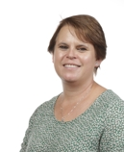
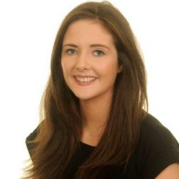
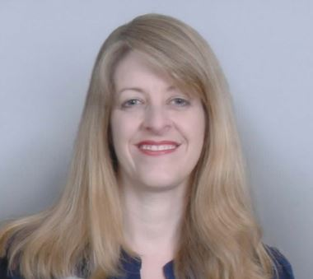
Our Senior Leadership Team
Mrs C. Moore
Headteacher
Ms T. Hackett
Assistant Headteacher
Mrs C. Smith
Assistant Headteacher & SENDCO
Mrs C. Smith
Assistant Headteacher
& SENDCO

Slide 6
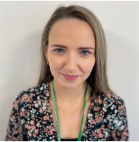
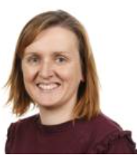
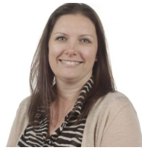
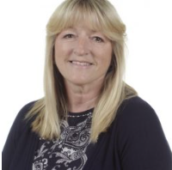
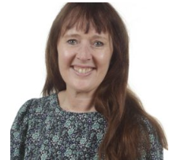
Year 2 Staff
Miss Campion
2C - Class teacher
Mrs Duffey
2D - Class teacher
(Wed-Fri)
Mrs Cooper
2D - Class teacher
(Mon – Tues)
Mrs Grogan
Year 2C Teaching Assistant
Mrs Wells
Year 2D Teaching Assistant
Mrs Earl will work across both classes.
Mrs C. Smith
Assistant Headteacher
& SENDCO

Slide 7
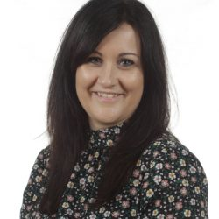
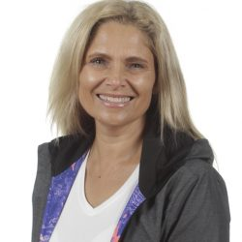
Other Staff Members
P.E and Music and will be covered by specialist teachers.
Mrs H Bowen
P.E Specialist
Mrs Z Flatt
Music Specialist
Mrs C. Smith
Assistant Headteacher
& SENDCO

Slide 8
Drop Off and Pick Up
The doors open at 8.45am and close at 8.55am. There is a soft start to the day and when the children arrive they start their SODA (Start of Day Activity) before lessons begin.
Please help your child settle by allowing them to come in to the classroom independently.
School finishes at 3.10pm.

Slide 9
Lunches
We use the ‘Pupil Choice’ system for lunch. Each child chooses their lunch at the beginning of the day.
Red: Meat/Fish option
Green: Vegetarian option
Yellow: Roll or sandwich
Blue: Jacket Potato
Alternatively, your child can bring in their own packed lunch. No glass bottles, fizzy drinks or any food containing nuts are allowed.
Mrs C. Smith
Assistant Headteacher
& SENDCO

Slide 10
KS2 School Stationery
Children may bring one simple pencil case labelled with their name containing:
A pencil and sharpener; 2 spare pencils
A black handwriting pen (not black biro) and a purple pen
A rubber
Colouring pencils and felt tips
A glue stick
A ruler - 30cm
Please ask your child to tell you when they need replacements. Stationery can be provided in school if your child does not want to bring their own pencil case.
Notes:
Maria
Please ensure pencil cases are of a modest size and only contain school equipment.

Slide 11
KS2 Uniform
Please ensure all items of clothing are
clearly marked with your child’s name.
Black school shoes must be worn – no trainers.
Long hair must be tied up with simple black, green or red ties.
Jewellery – children may only wear simple stud earrings and a silent watch or Fitbit (no smartwatches allowed).
Appropriate outer wear must be provided as children play outside.
Red caps are required to be worn on sunny days and during trips.

Slide 12
KS2 PE Kit
Please ensure all items of clothing are
clearly marked with your child’s name.
Children need to have correct PE Kit in school for their PE days. Our PE days are Monday and Friday. P.E kits to be brought in on Mondays and kept in school until Fridays.
Plain white T shirt (with or without school logos but no other logos)
Red shorts
Plain trainers with non-marking soles
Optional for cold weather – Plain dark tracksuit bottoms and sweatshirt for outdoor use, i.e. black, navy, or green without logos
Red drawstring bag (clearly labelled)
No jewellery should be worn.

Slide 13
R.E.: Come and See
Autumn Term
Domestic Church - Loving
Baptism/Confirmation - Vocation and Commitment
Judaism - Rosh Hashanah, Yom Kippur
Advent/Christmas: Expectations
Spring Term
Local Church – Sources
Eucharist - Unit
Lent/Easter – Death & New Life
Summer Term
Pentecost – Witnesses
Islam
Reconciliation/Anointing of the sick - Healing
Universal Church – Common Good
Notes:
Lisa

Slide 14
Maths in Year 6
Notes:
delete

Slide 15
Reading in Year
Notes:
delete

Slide 16
Phonics in Year
Notes:
delete

Slide 17
Writing in Year 6
Notes:
delete

Slide 18
Science in Year 6

Slide 19
Other curriculum topics in Year 6

Slide 20
SATs in Year 6

Slide 21
Home Learning

Slide 22
How you can help at home

Slide 23
Parent Helpers
The support of parents is of enormous benefit to the children and we warmly welcome it.
We can now invite parent volunteers back to help in school. If you are interested in becoming a volunteer, please notify the office and further information will follow.
(Please note that in line with Hertfordshire County Council, all parents working in school will be asked to apply for police clearance.)
Notes:
Lisa

Slide 24
Any Questions?
If you have any further questions after the welcome meeting, please email the office:
admin@ssas.herts.sch.uk
We will try to get back to you as soon as possible.

Slide 25
Thank you for your support.
We hope that you found this information useful. We are very much looking forward to getting to know your families and children this year.

