Slide 1
St Alban & St Stephen Catholic Primary School & Nursery Welcome to Year 1
Learning and Growing with God by our Side
September 2022

Slide 2
Our School Prayer
Dear God,
Bless all the children and staff in our school.
Bless all our loving parents, our school community and parishioners.
Let us follow the shining examples of St Alban and St Stephen.
Help us to be the best that we can be and guide us as we stay connected to you and Jesus in all that we do.
As a school, we are learning and growing with God by our side.
Amen.

Slide 3
Our Mission Statement
Learning and Growing with God by our Side

Slide 4
Our School Values
Faith
Friendship
Determination
Respect
Unity
Our Golden Rules
We are gentle
We are kind and helpful
We listen
We are honest
We work hard
We look after property

Slide 5
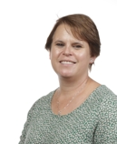
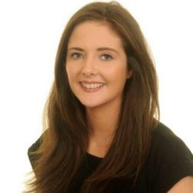
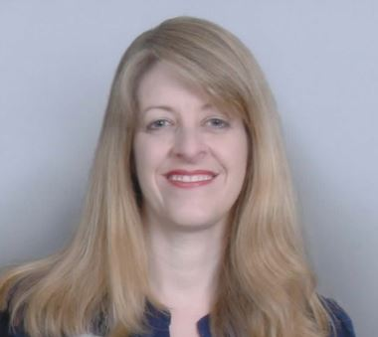
Our Senior Leadership Team
Mrs C. Moore
Headteacher
Ms T. Hackett
Assistant Headteacher
Mrs C. Smith
Assistant Headteacher & SENDCO
Mrs C. Smith
Assistant Headteacher
& SENDCO

Slide 6
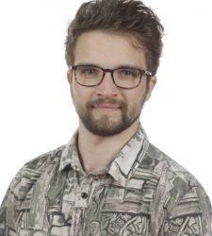
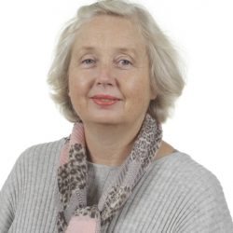
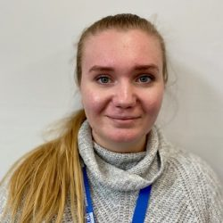
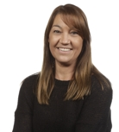
Year 1 Staff
Mr P. Miller
Year 1M
Class Teacher
Mrs A. Moss
Year 1M
Teaching Assistant
Miss A. Cotterell
Year 1C
Class Teacher
Mrs A. Lobue
Year 1C Teaching Assistant
Mrs L. Ojo
Year 1M
Teaching Assistant

Slide 7
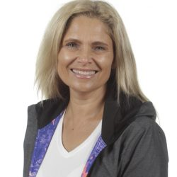
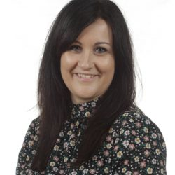
Other Staff Members
P.E and Music will be covered by specialist teachers.
Mrs H. Bowen
P.E Specialist
Mrs Z. Flatt
Music Specialist

Slide 8
Drop Off and Pick Up
The doors open at 8.45am and close at 8.55am. There is a soft start to the day and when the children arrive they start their SODA (Start of Day Activity) before lessons begin.
Please help your child settle by allowing them to come in to the classroom independently.
School finishes at 3.10pm.

Slide 9
Lunches
Children can either have school dinners each day or can bring in their own packed lunch.
They are provided with a snack in school. You do not need to send in any snacks.
You can view the menu on our website.
Please look at the menu with your child and talk
through the daily choices.

Slide 10
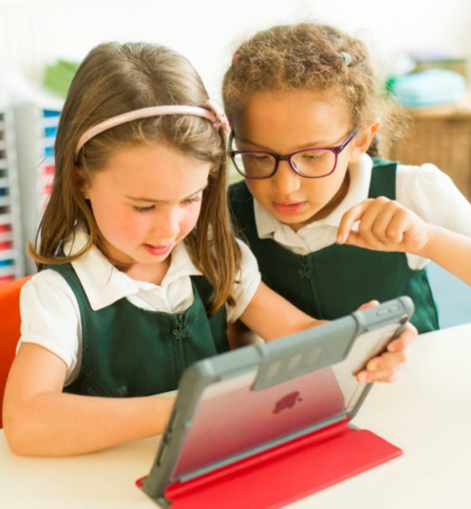
KS1 Uniform
Please ensure all items of clothing are
clearly marked with your child’s name.
Black school shoes must be worn – no trainers.
Long hair must be tied up with simple black, green or red ties.
Jewellery – children may only wear simple stud earrings and a silent watch or Fitbit (no smartwatches allowed).
Appropriate outer wear must be provided as children play outside.
Red caps are required to be worn on sunny days and during trips.

Slide 11
KS1 PE Kit
Please ensure all items of clothing are
clearly marked with your child’s name.
Children need to have correct PE Kit in school for their PE days. Our PE day is Wednesday. The children will come home in their P.E kit. Please make sure it is returned for the following Wednesday.
Plain white T shirt (with or without school logos but no other logos)
Red shorts
Plain trainers with non-marking soles
Optional for cold weather – Plain dark tracksuit bottoms and sweatshirt for outdoor use, i.e. black, navy, or green without logos
Red drawstring bag (clearly labelled)
No jewellery should be worn.

Slide 12
R.E.: Come and See
Autumn Term
Domestic Church: Families
Baptism: Belonging
Judaism: Abraham and Moses
Advent/Christmas: Waiting
Spring Term
Local Church: Special people
Eucharist: Meals
Lent/Easter: Change
Summer Term
Pentecost: Holidays and Holydays
Reconciliation: Being Sorry
Islam: Mohammed the holy man
Universal Church: Neighbours
Notes:
Lisa

Slide 13
Maths in Year 1
Daily Maths lesson/Maths fluency 3 x a week
In Year 1, we explore Number, Measurement, Geometry (Shapes, Position and Direction).
We aim to develop a strong visual awareness of number and use a lot of practical equipment in the classroom.
Notes:
delete

Slide 14
Phonics in Year 1
We have recently introduced a new scheme ‘Little Wandle’.
Little Wandle provides a completely consistent approach to planning, resources and delivery
How do we teach children phonics?
We teach phonics everyday.
The children learn four new sounds each week and have a regular review lessons to
consolidate this learning.
Phonics is learnt in ‘phases’ as a whole class.
Notes:
delete

Slide 15
Reading in Year 1
Each week the children will take part in up to three reading practice sessions. At the end of each week the children will be sent home with the book they have been practising.
Each reading practice session has a clear focus, so that the demands of the session do not overload the children’s working memory.
Three books will be sent home each week: Reading practice and Individual reading books (which are fully decodable) and a Library book (which is for sharing with an adult to promote the love of reading).
Our current Library day is every Thursday!
Notes:
delete

Slide 16
Writing in Year 1
In Year 1, the children will be writing every day, in a range of different contexts.
We still encourage mark making and developing a love for writing through child-initiated learning.
Our school use the Pen Pals handwriting scheme, which is consistent with
the letter formation of Little Wandle.
Notes:
delete

Slide 17
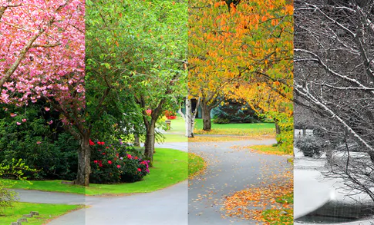
Science in Year 1
Autumn 1: Seasons/ourselves
Autumn 2: Common and wild garden plants and materials
Spring 1: Seasons and materials
Spring 2: Animals and life processes
Summer 1: Seasons and animals
Summer 2: Humans

Slide 18
Other curriculum topics in Year 1
Computing
Topic (history and geography)
Art and DT
PSHE
Music
P.E

Slide 19
Home Learning
Each half term, the children will receive a home learning grid. Please complete at least two pieces from the grid, as well as one RE piece.
The grid will be uploaded to Google Classroom and children should submit their work via Google Classroom when they complete a task.
Work which cannot be uploaded can be brought into school to share e.g. art activities.
Children should read for a minimum of 10 minutes each night. Please remember to comment
in their reading record.
Every Wednesday, Phonics and/or Spelling Practice will be added to Google Classroom
for you to practise with your child at home.

Slide 20
How you can help at home
Always encourage and discuss the schools Golden Rules.
Reading daily with your child. Find opportunities to read spontaneously.
Help your child grow in independence (i.e. getting changed, resolving issues).
Model and teach life skills (i.e. logging into a computer, using money, maintain a healthy diet, gardening, DIY)
Play lots of games and encourage turn taking and counting.
Making time for completing home learning to a high quality.

Slide 21
Parent Helpers
The support of parents is of enormous benefit to the children and we warmly welcome it.
We can now invite parent volunteers back to help in school. If you are interested in becoming a volunteer, please notify the office and
further information will follow.
(Please note that in line with Hertfordshire County Council, all
parents working in school will be asked to apply for police clearance.)
Notes:
Lisa

Slide 22
Any Questions?
If you have any further questions after the welcome meeting, please email the office:
admin@ssas.herts.sch.uk
We will try to get back to you as soon as possible.

Slide 23
Thank you for your support.
We hope that you found this information useful. We are very much looking forward to getting to know your families and children this year.

