Slide 1
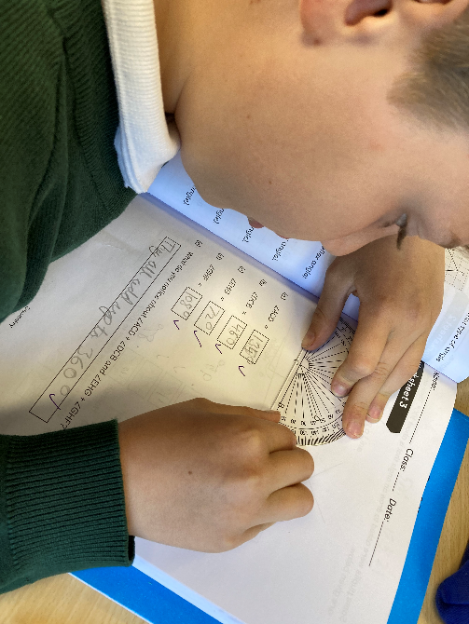
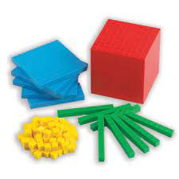
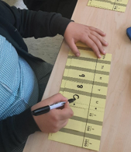
Maths at St Alban & St Stephen Catholic Primary School & Nursery
Parent Meeting for KS2
Parents

Slide 2
Our aim at St Alban and St Stephen Primary School is that children will learn to be confident in exploring and using a wide range of maths skills that they can build on in their future learning and use in their adult lives.
The purpose of Maths is the pursuit for truth and the thinking skills developed through the Maths Curriculum should inspire learners to be innovative, creative, critical and analytical learners. Enjoying the beauty of Maths enables learners to engage with the transcendent dimensions of life. It will inspire them to become the pioneers and inventors of today and the future.

Slide 3
How children learn maths.
Using practical mathematical resources
Exploring and investigating
Using Talk for Learning
Representing learning using pictures and then more abstract

Slide 4
Herts for Learning Essential maths Scheme is used across the whole school.
This scheme is used across both sites to ensure consistency and progression.
Scheme uses sequences of lessons for each year group.
High emphasis on using mathematical equipment for practical learning.
Problem solving skills embedded throughout.
Children learn to record using pictorial representations and more abstract recording e.g. number sentences.
Talk for learning also important – speaking frames support children’s use of mathematical language.

Slide 5
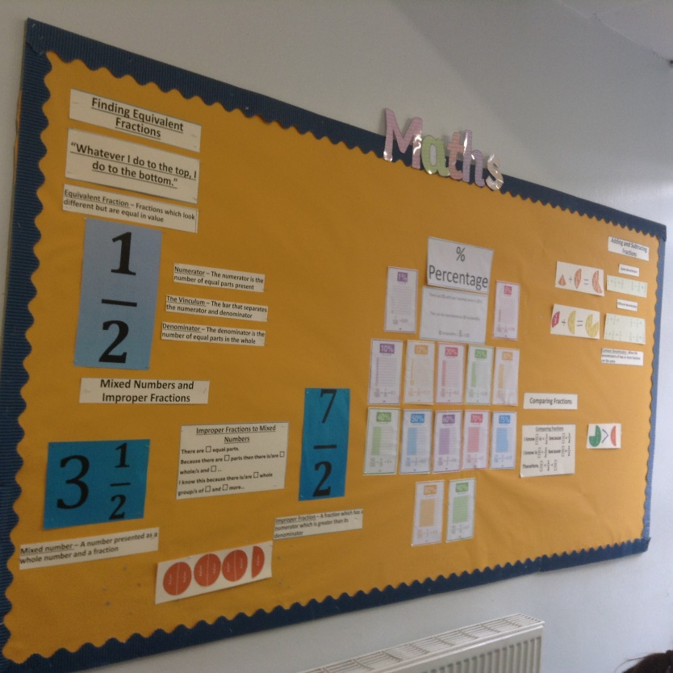
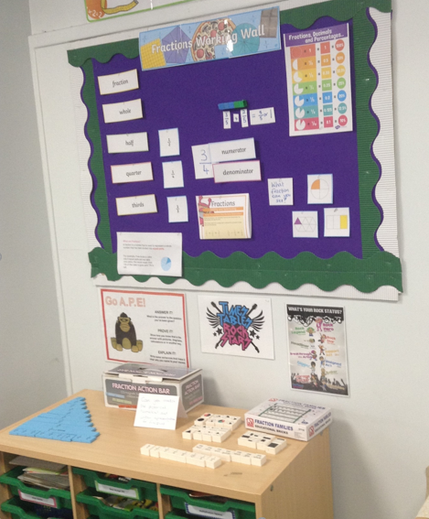
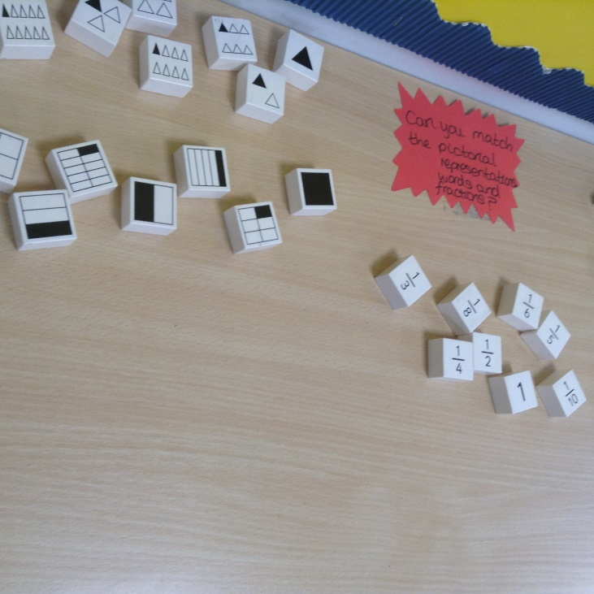
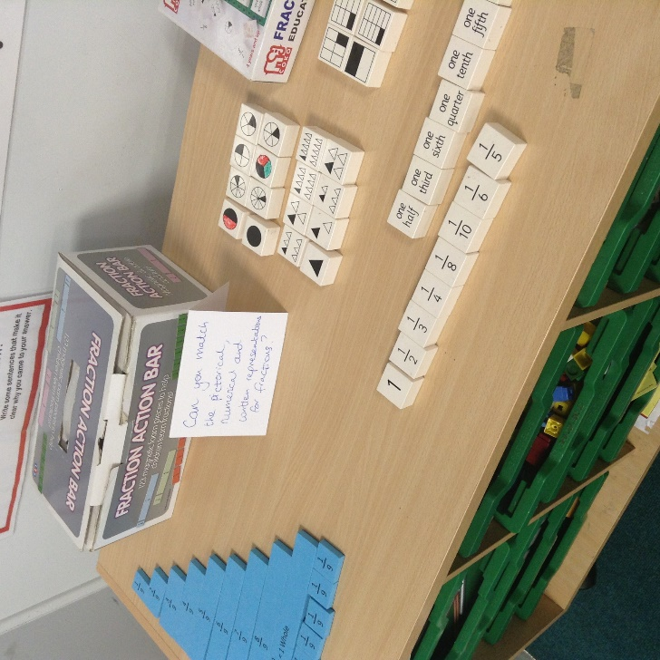
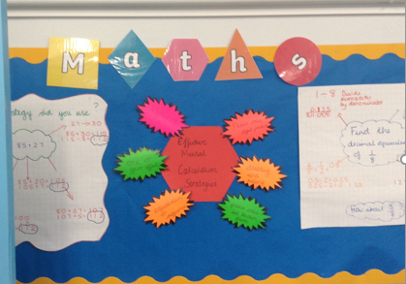
Key Stage 2 Working Walls

Slide 6
Speaking frames

Slide 7
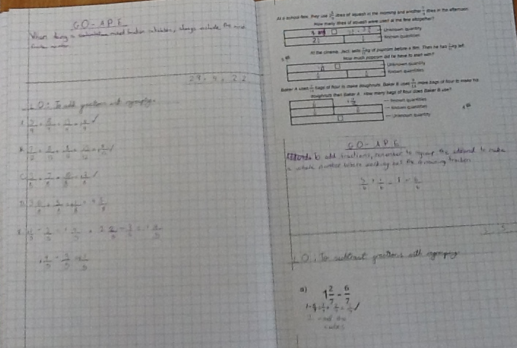
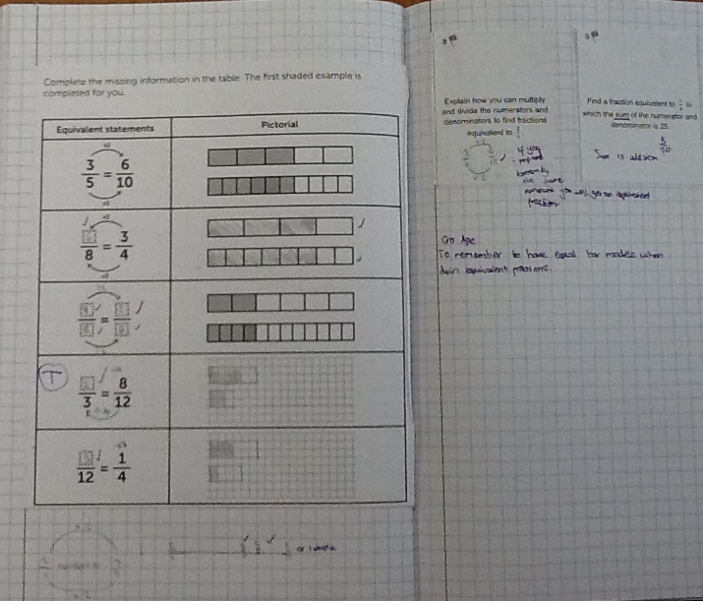
KS2 Purple Pen and Go APE
Marking our work
Go APE (Answer, Prove, Explain)

Slide 8
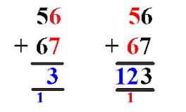
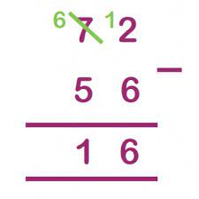
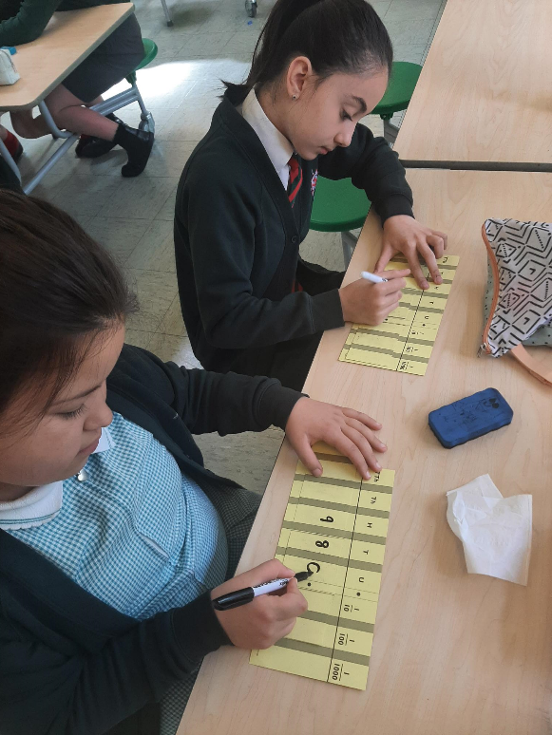
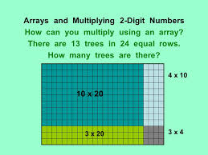
Key Stage 2
More formal methods of recording, such as column method for addition and subtraction.
Place value – Millions, hundred thousands, ten thousands, thousands, hundreds, tens and ones.
Develop fluent recall of times tables.
Fractions, decimals and percentages – including calculations.
Multiplication and division of 2 digit numbers.

Slide 9
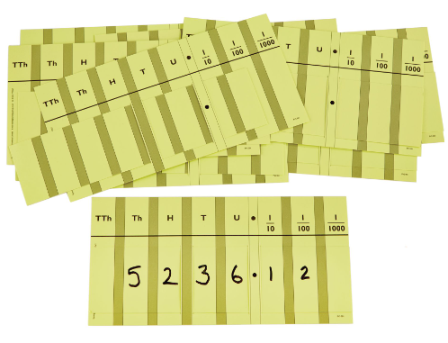
Place Value
Place value sliders
Year 3 – hundreds, begin decimals
Year 4 – thousands
Year 5 – ten thousands and hundred thousands
Year 6 – hundred thousands and millions
Base Ten
Counting stick

Slide 10
Addition and Subtraction
Mental strategies – e.g Think 10, Think 100, regrouping, rebalancing
Formal written strategies.

Slide 11
Think 10
Think 10 e.g. 68 +8 = 70+6 | Rebalancing for addition e.g. 48 +27 = 50 + 25
Think 100 e.g. 430 + 75 = 500 + 5 | Rebalancing for subtraction (equal difference) e.g. 69 – 15 = 70-16
Rebalancing
Regrouping
Place value

Slide 12
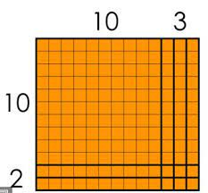
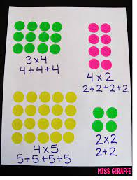
Multiplication and Division
At the end of Year 4 children should have quick mental recall of all times tables up to 12x tables.
Throughout KS2 they will develop strategies for multiplying 2 digit numbers.
They will also learn to do long multiplication and long division.

Slide 13
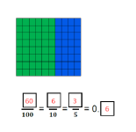
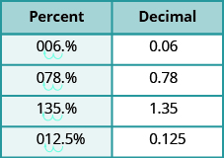
Fractions, percentages and decimals

Slide 14
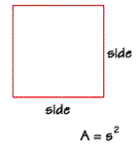
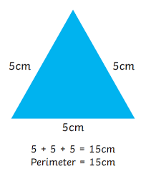
Shape
Names and properties of 2D and 3D shapes.
Perimeter
Area

Slide 15
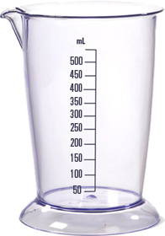
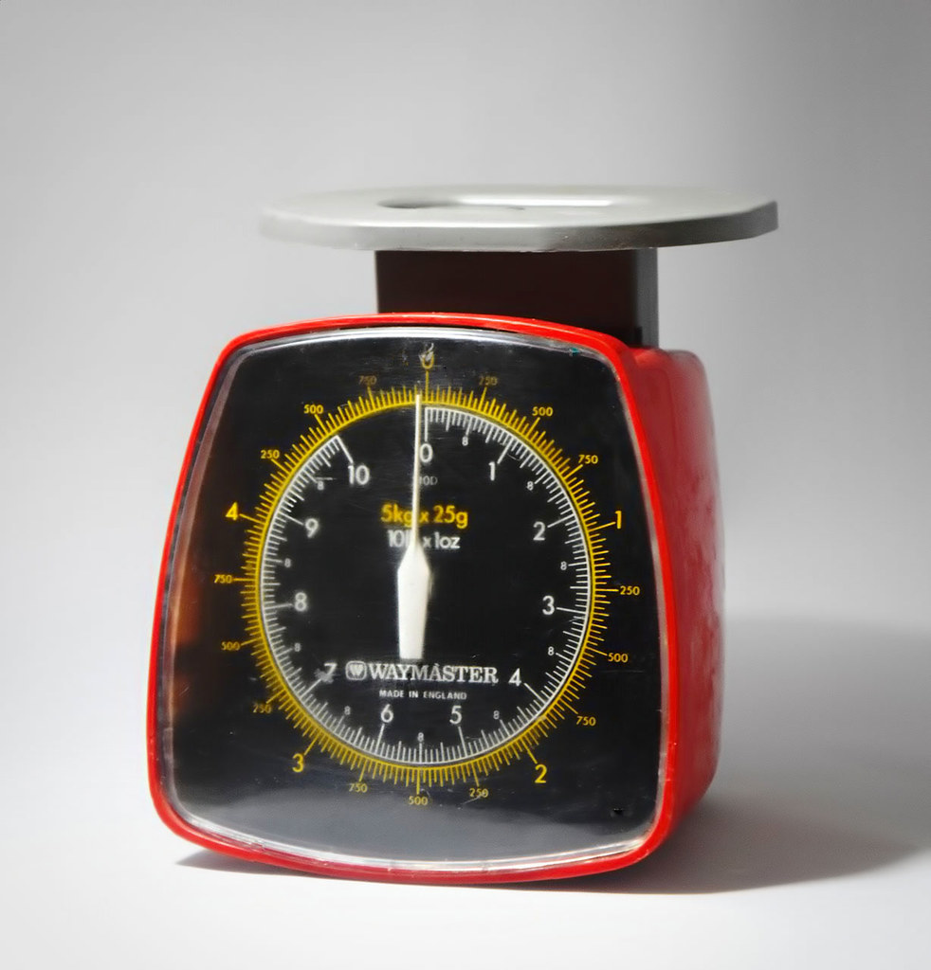
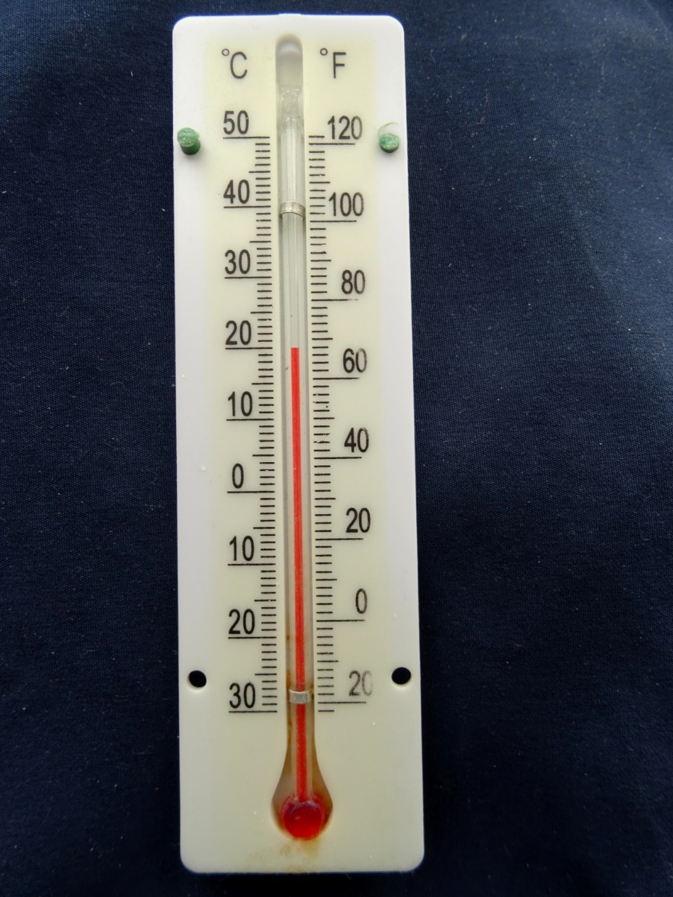
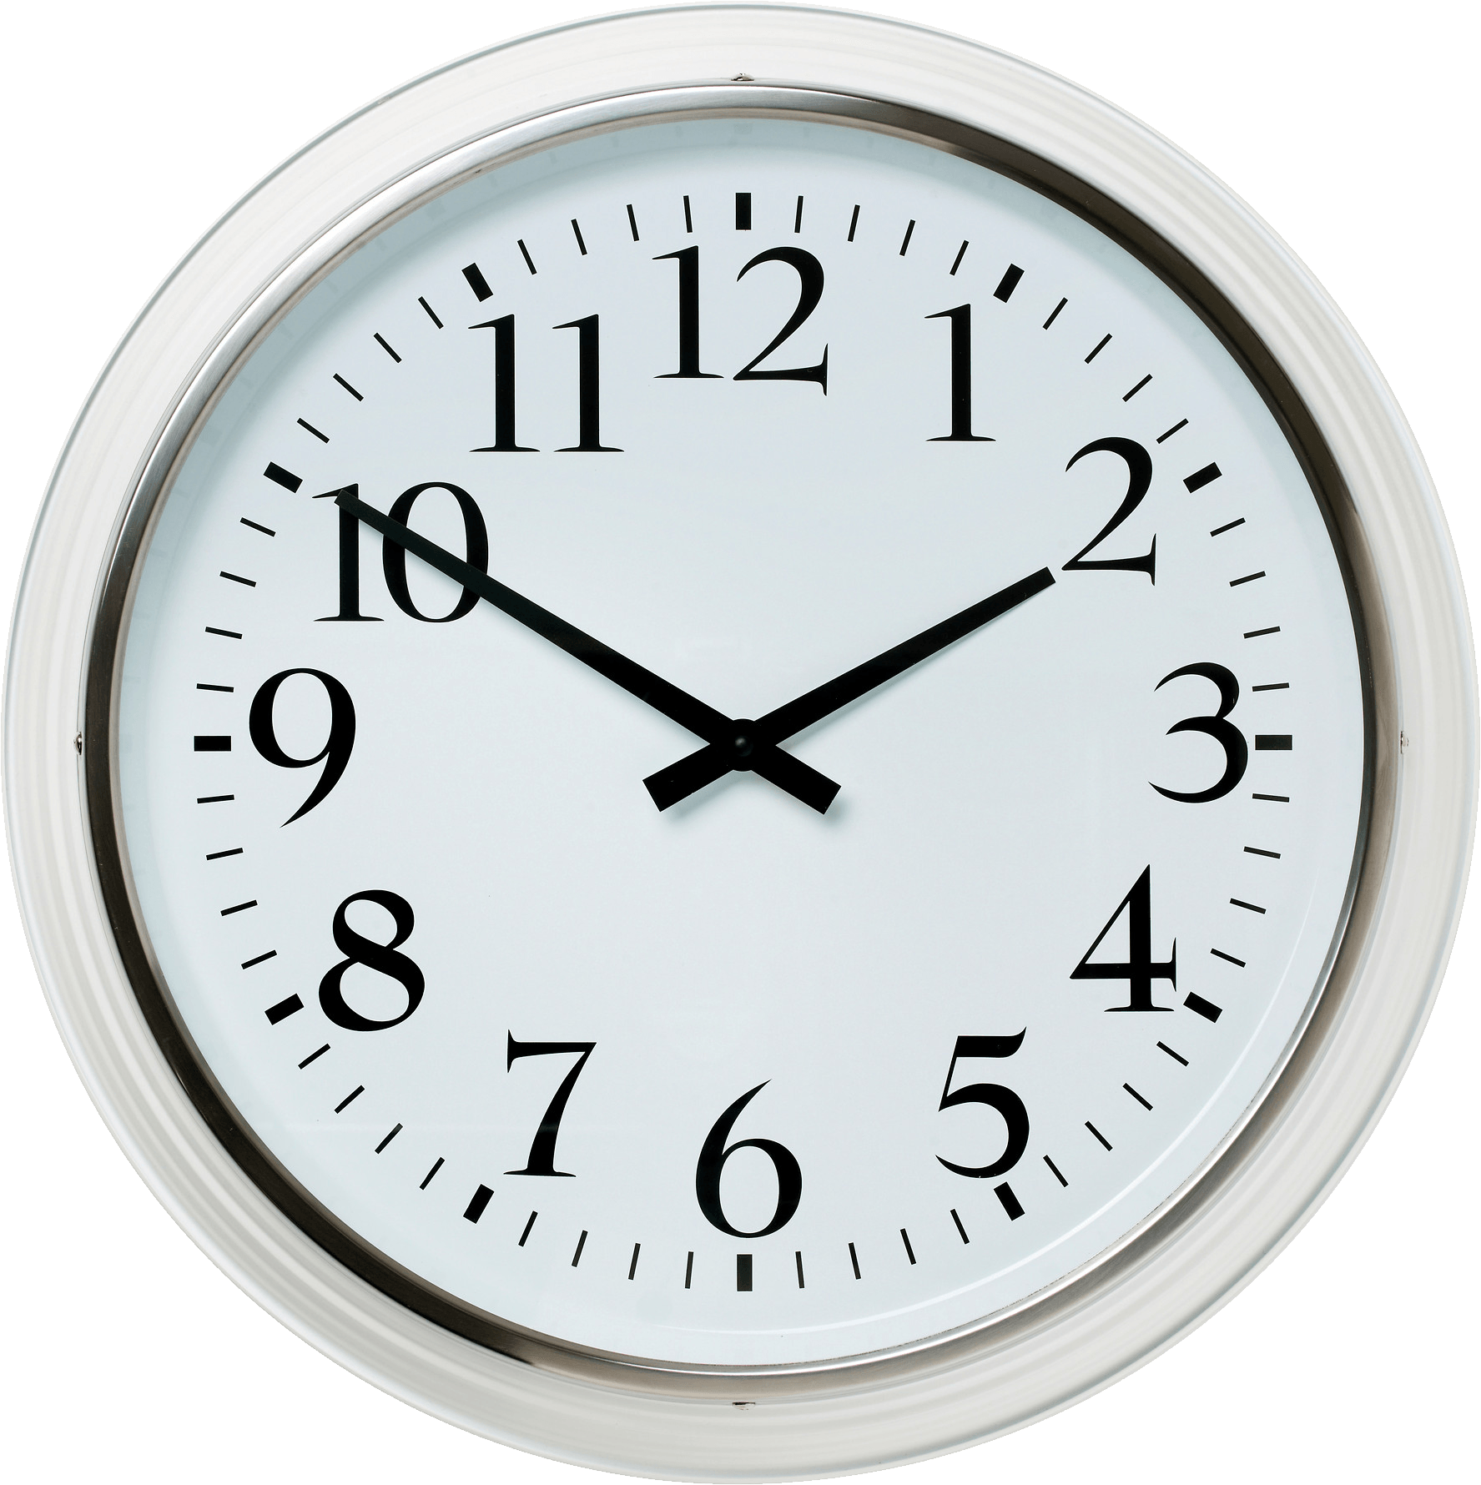
Measures
weighing
temperature
capacity
time

Slide 16
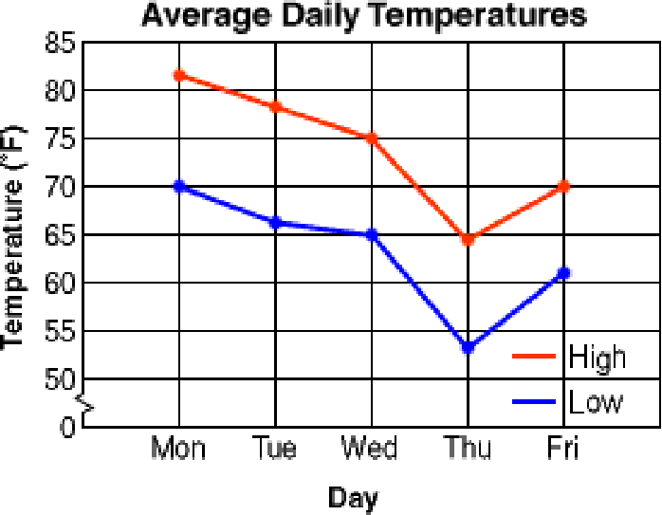
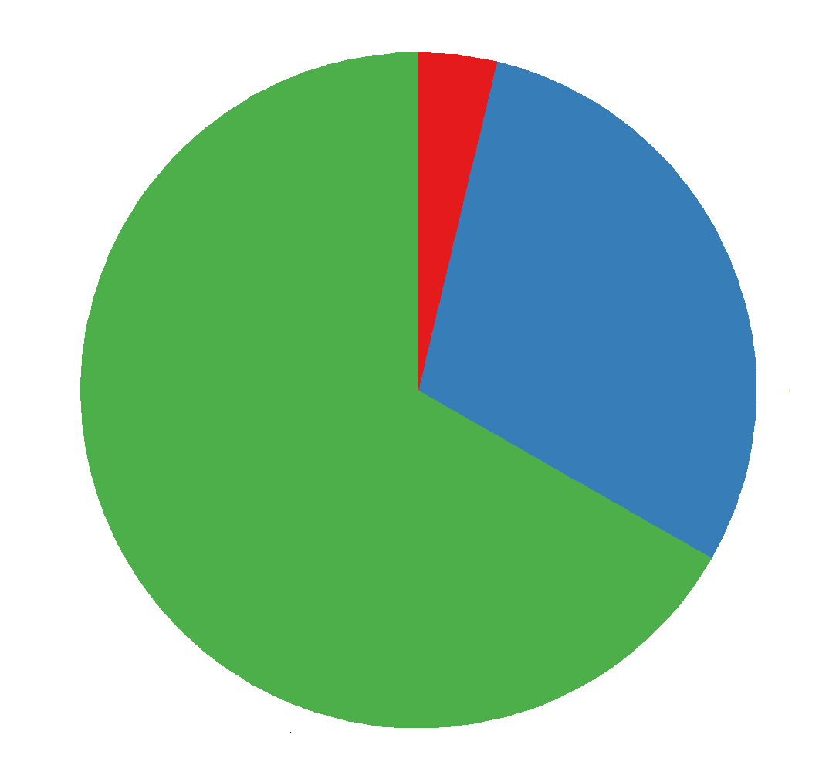
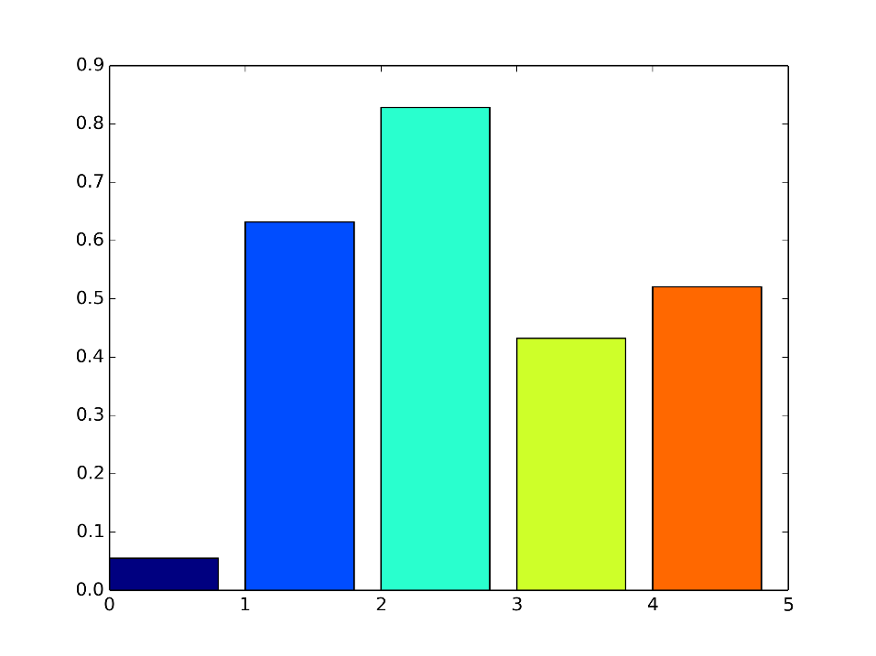
Data handling
Line graphs
Pie charts
timetables
Bar charts

Slide 17
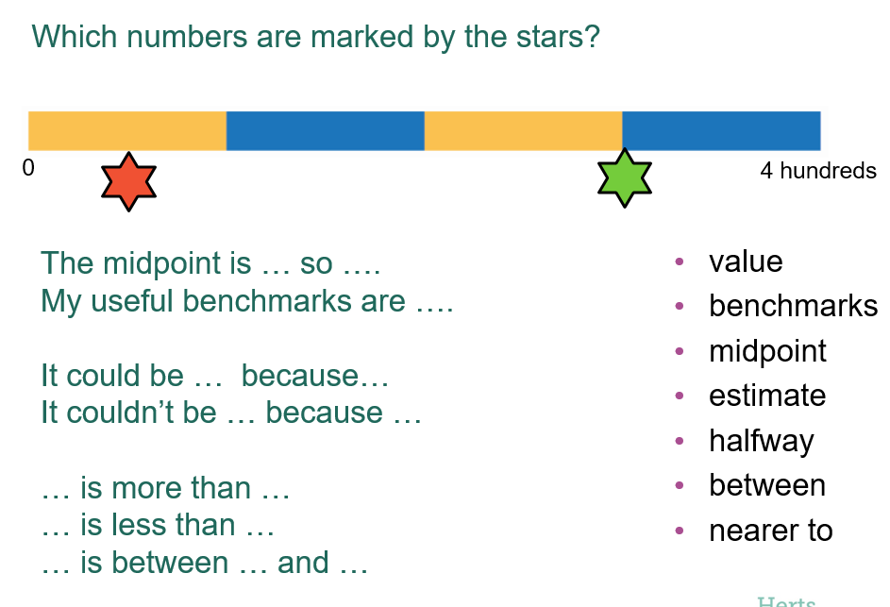
Maths Fluency
Children spend 10-15 minutes per day on Maths fluency.
Revisit previous maths learning.
Develop quick recall of number facts.
Times tables.

Slide 18
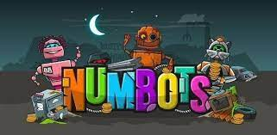
Home Learning
Maths choices on Home Learning Grid
Weekly homework – using board games for younger children, My Maths computer program (completing tasks set by teachers), Times Tables Rockstars and Numbots online maths.

Slide 19
Further ways to support your child at home.
Cooking – uses variety of Maths skills in real life contexts – such as weighing, reading a scale and time.
Playing board games – dice reinforce subitising skills, moving counters 1:1 correspondence, snakes and ladders develops number recognition, quick recall addition and subtraction facts.
Card games and dominoes.
Looking at clocks at home – analogue and digital.
Money – playing shopping games and giving children opportunities to use money in real life situations.
BBC Bitesize and Herts for Learning games (YouTube).

Slide 20
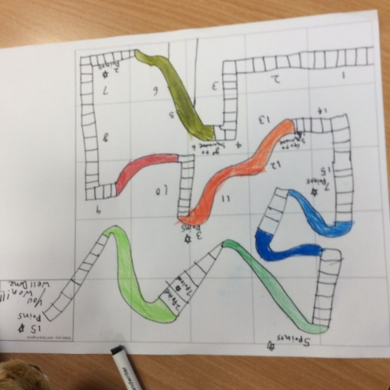
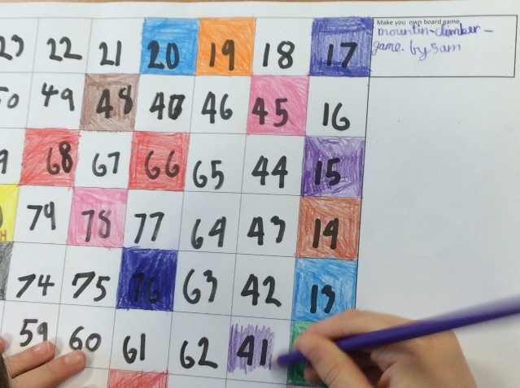
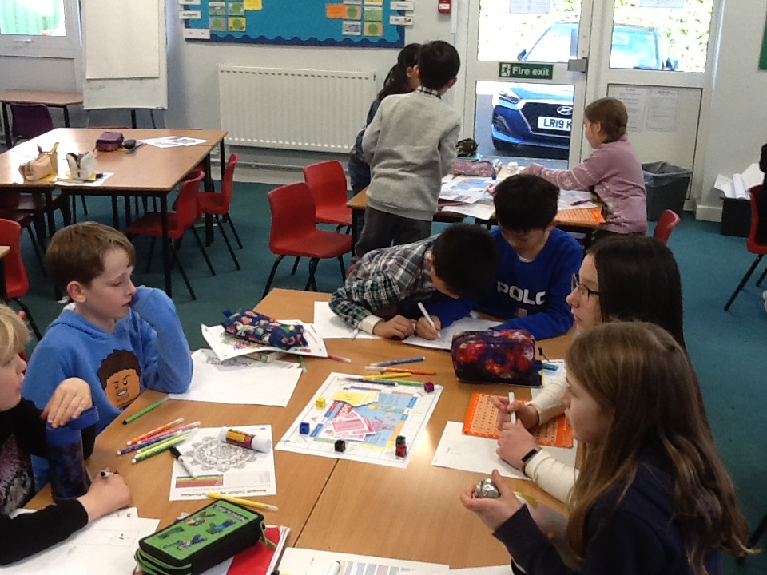
Making maths fun!
NSPCC Maths Day May 2022
Children dressed up with numbers and patterns.
Art activities with maths theme.
Maths stories.
Outdoor learning.

Slide 21
Thank you for listening.
We are happy to answer any questions that you may have.

