Slide 1
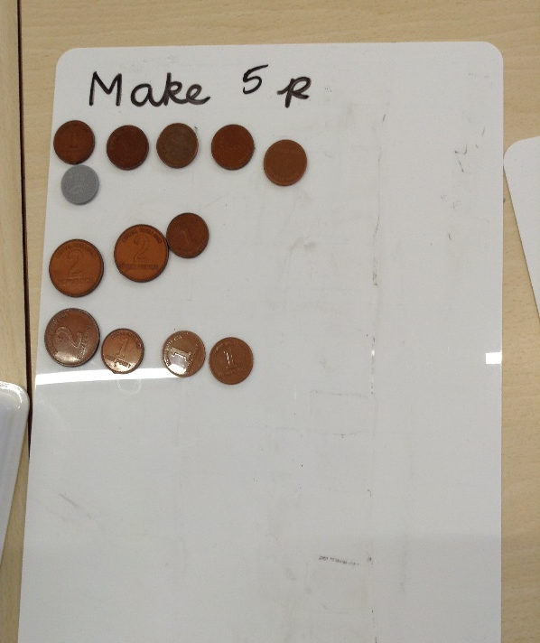
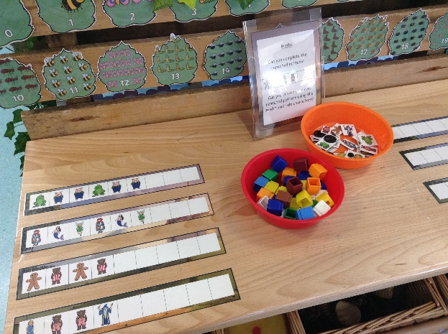
Maths at St Alban & St Stephen Catholic Primary School & Nursery
Meeting for EYFS and
Key Stage 1 Parents

Slide 2
Our aim at St Alban and St Stephen Primary School is that children will learn to be confident in exploring and using a wide range of maths skills that they can build on in their future learning and use in their adult lives.
The purpose of Maths is the pursuit for truth and the thinking skills developed through the Maths Curriculum should inspire learners to be innovative, creative, critical and analytical learners. Enjoying the beauty of Maths enables learners to engage with the transcendent dimensions of life. It will inspire them to become the pioneers and inventors of today and the future.

Slide 3
How children learn maths.
Using practical mathematical resources
Exploring and investigating
Using Talk for Learning
Representing learning using pictures and then more abstract

Slide 4
Herts for Learning Essential maths Scheme is used across the whole school.
This scheme is used across both sites to ensure consistency and progression.
Scheme uses sequences of lessons for each year group.
High emphasis on using mathematical equipment for practical learning.
Problem solving skills embedded throughout.
Children learn to record using pictorial representations and more abstract recording e.g. number sentences.
Talk for learning also important – speaking frames support children’s use of mathematical language.

Slide 5
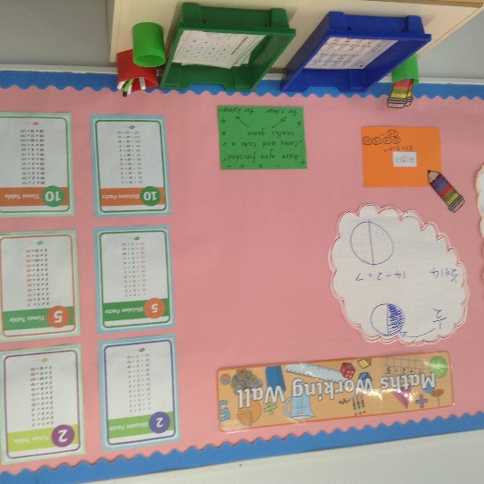
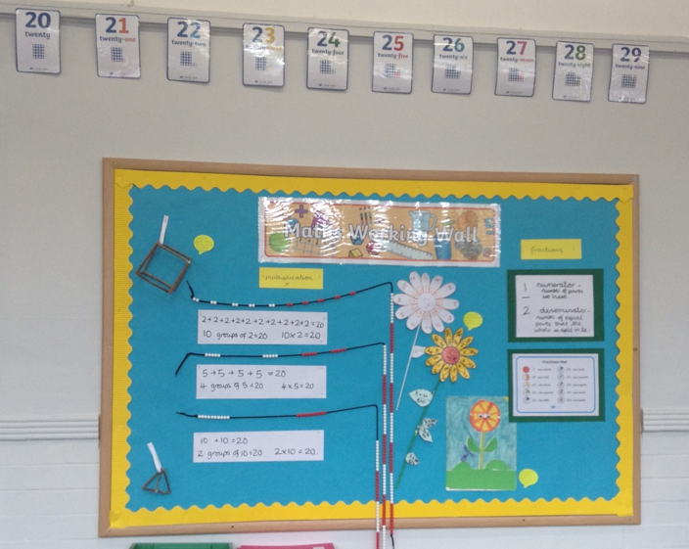
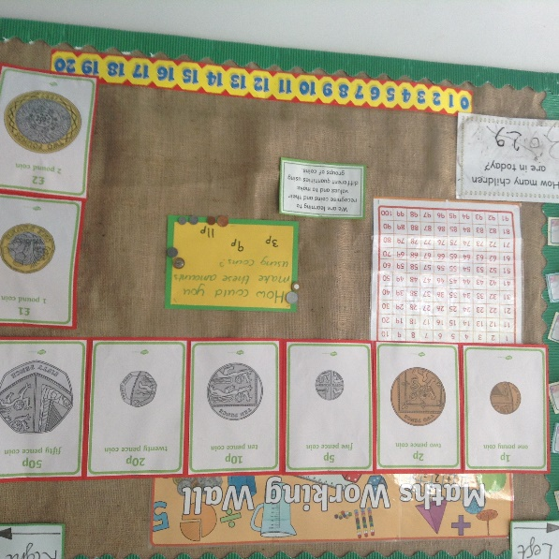
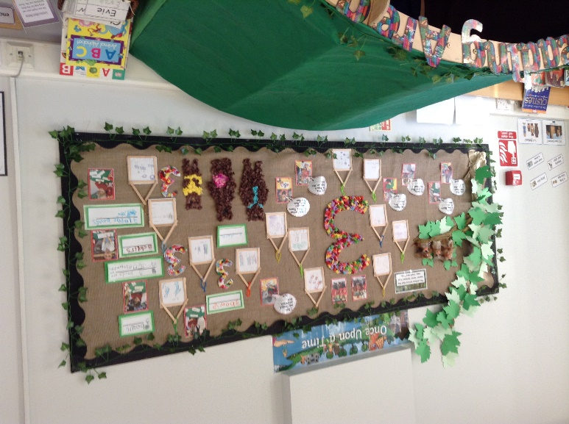
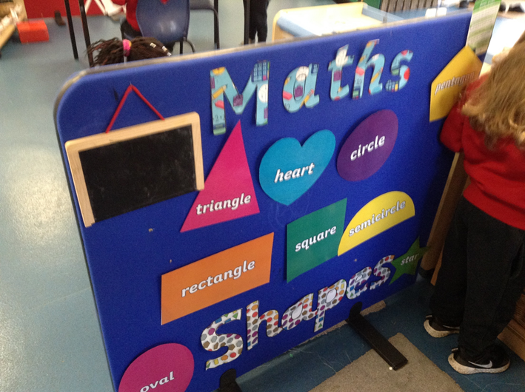
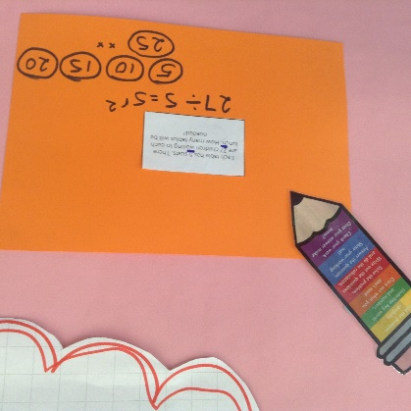
Our classroom environments
Children are encouraged to access wide range of resources independently.
Working walls and interactive maths displays encourage pupil learning.
Reception
Year 1
Nursery
Year 2

Slide 6
Speaking frames

Slide 7
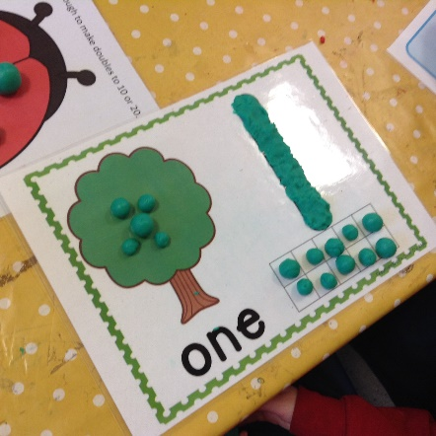
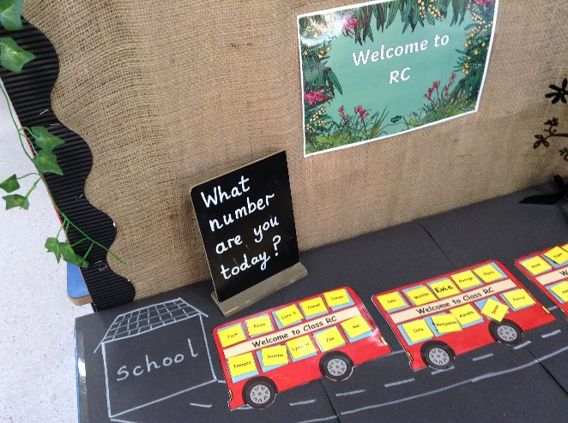
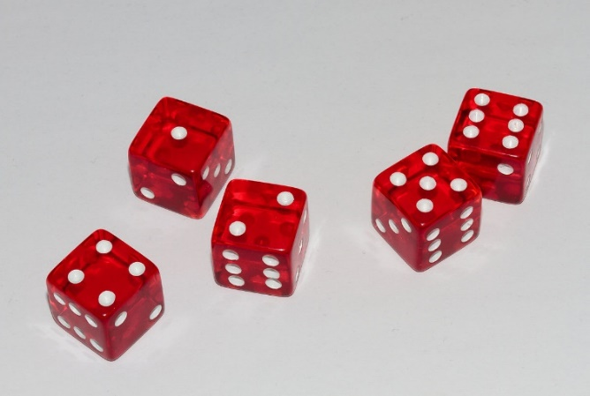
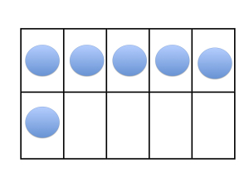
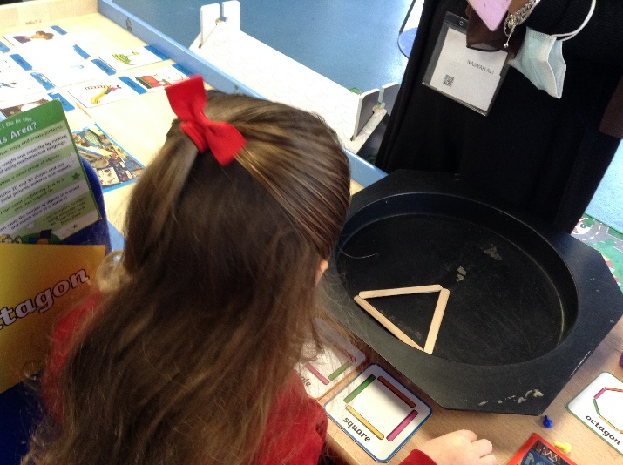
Maths in Early Years Foundation Stage
Learning to subitise – recognising number patterns without needing to count.
Dice games and tens frames.
Using language to compare e.g. more, fewer, near, far.
Lots of opportunities for development of maths skills through Child Initiated Learning.

Slide 8
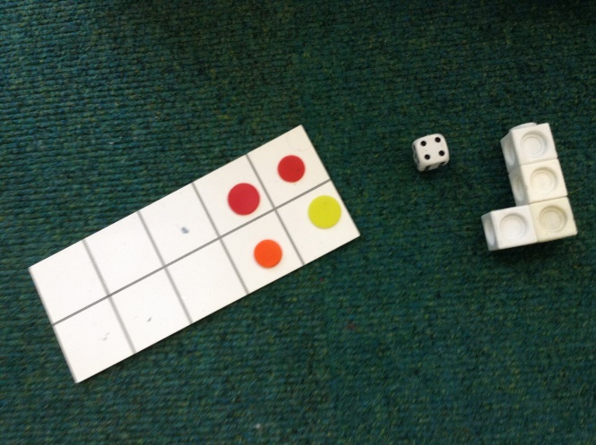
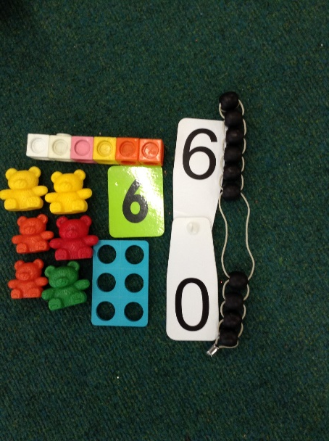
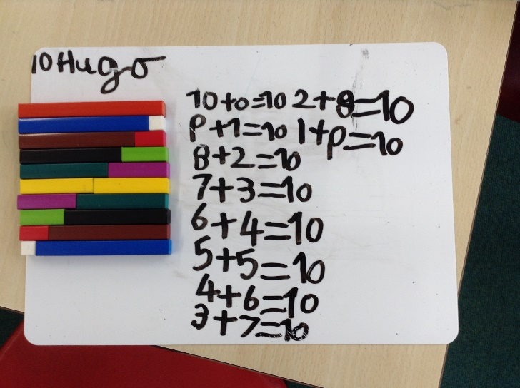
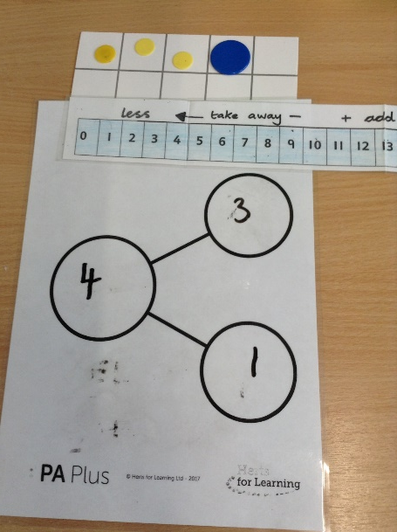
Maths in Key Stage 1
Continue to develop subitising skills – e.g. with tens frames
Representing and regrouping numbers in different ways
Place value – what each digit represent in a 2 digit number
Recognising odd and even numbers.
Discovering link between addition and subtraction.
Practical multiplication and division – grouping and arrays

Slide 9
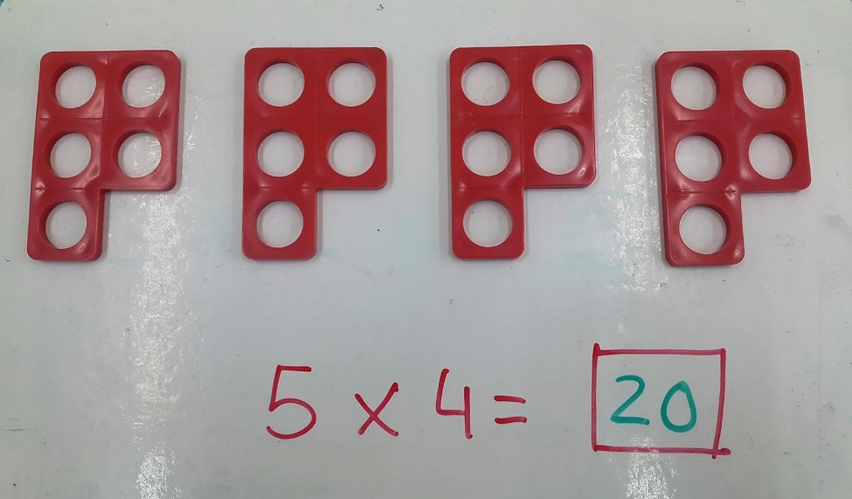
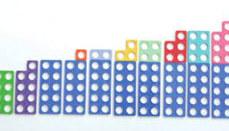
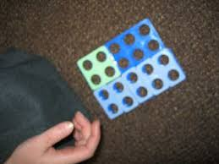
Numicon
Multiplication
Teens numbers – tens and ones
Odd and even numbers
Explore equivalence
Number bonds to 10

Slide 10
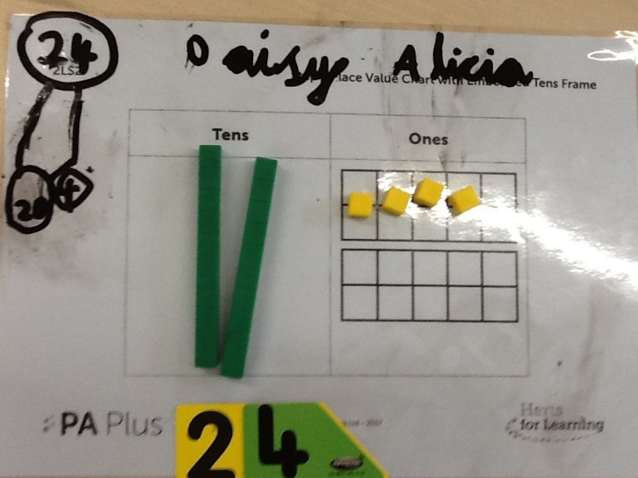
Place value

Slide 11
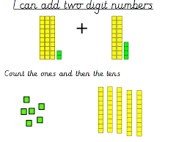
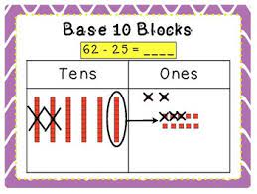
Addition and Sutraction
Base Ten
Regrouping – making different groups to represent different numbers e.g. exchanging 1 ten for 10 ones.

Slide 12
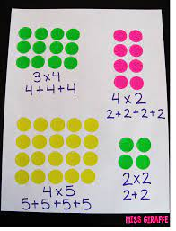
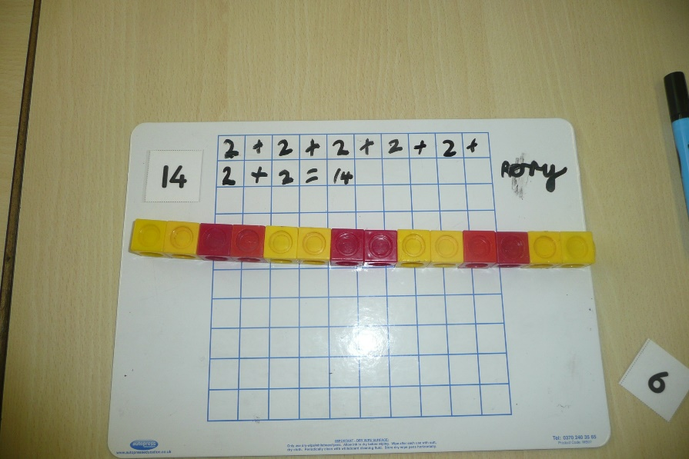
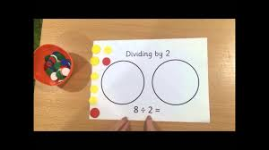
Multiplication and division
Arrays
2x, 5x, 10x and 3x tables
Sharing
Grouping

Slide 13
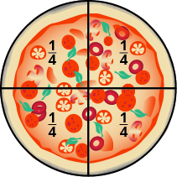
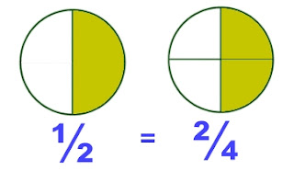
Fractions
Fractions of shape
Fractions of numbers
Equivalent fractions
Links to multiplication and division

Slide 14
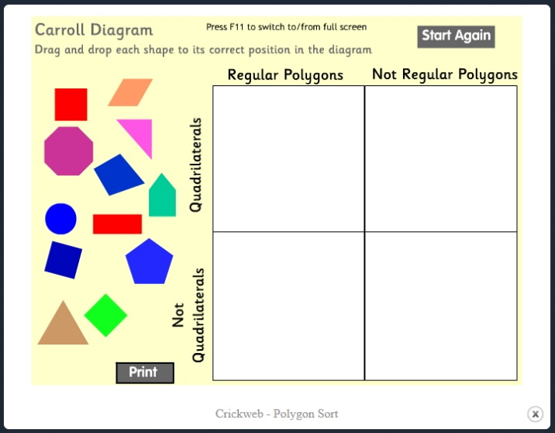
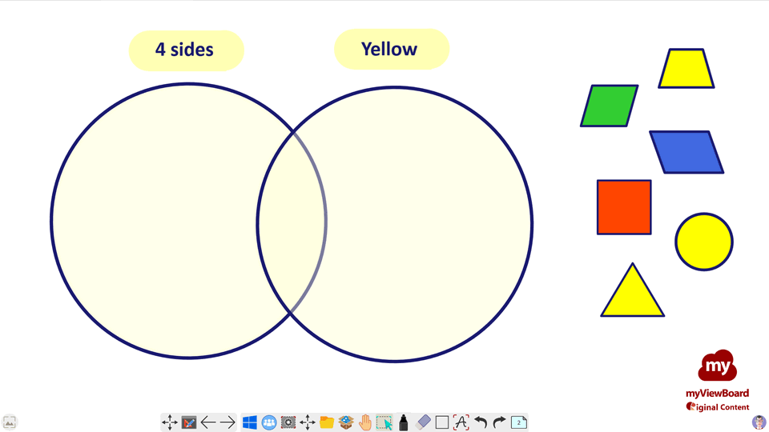
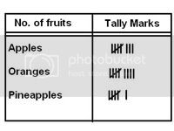
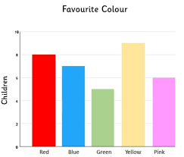
Data handling

Slide 15
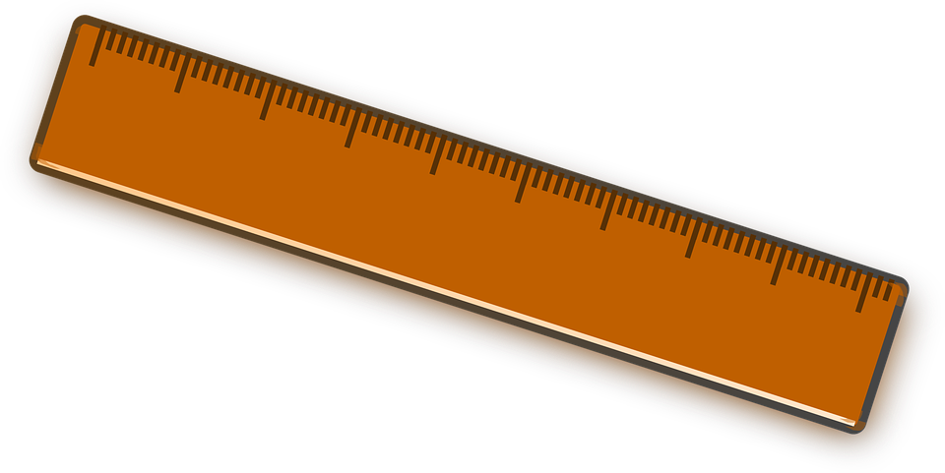
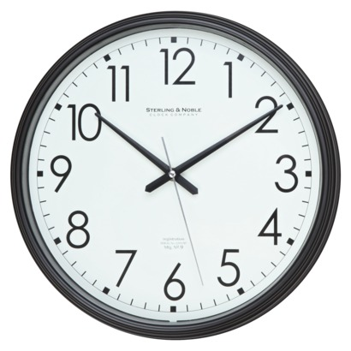
Measures
length
Mass
capacity
time

Slide 16
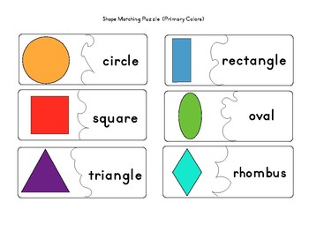
Shape
face
vertices
edge
curved
flat
surface
Name and describe 2D and 3D shapes

Slide 17
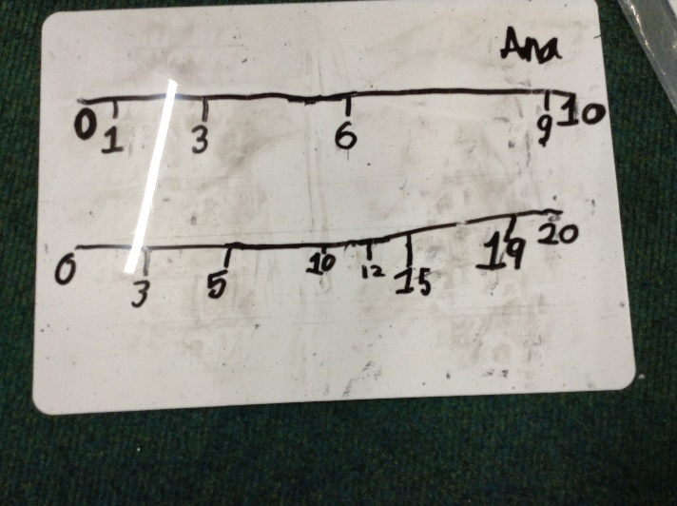
Maths Fluency
Children spend 10-15 minutes per day on Maths fluency.
Revisit previous maths learning
Develop quick recall of number facts.

Slide 18
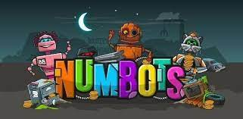
Home Learning
Maths choices on Home Learning Grid
Weekly homework – using board games for younger children, My Maths computer program (completing tasks set by teachers), Times Tables Rockstars and Numbots online maths.

Slide 19
Further ways to support your child at home.
Cooking – uses variety of Maths skills in real life contexts – such as weighing, reading a scale and time.
Playing board games – dice reinforce subitising skills, moving counters 1:1 correspondence, snakes and ladders develops number recognition, addition and subtraction.
Card games and dominoes.
Looking at clocks at home – analogue and digital.
Money – playing shopping games and giving children opportunities to use money in real life situations.
BBC Bitesize.

Slide 20
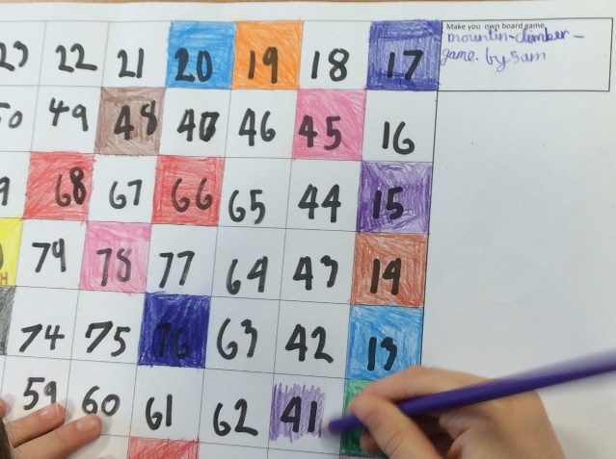
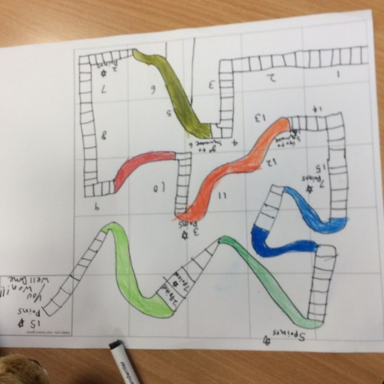
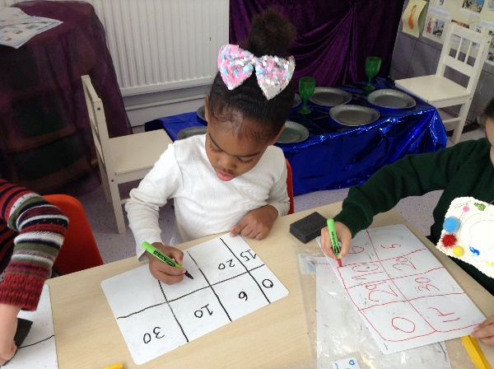
Making maths fun!
NSPCC Maths Day 2022.
Children dressed up with numbers and patterns.
Art activities with maths theme.
Maths stories.
Outdoor learning.
Maths Day 2023 – February

Slide 21
Thank you for listening.
We are happy to answer any questions that you may have.

