Slide 1
St Alban & St Stephen Catholic Primary School & Nursery Welcome to Year 4
Learning and Growing with God by our Side
September 2023

Slide 2
Our School Prayer
Dear God,
Bless all the children and staff in our school.
Bless all our loving parents, our school community and parishioners.
Let us follow the shining examples of St Alban and St Stephen.
Help us to be the best that we can be and guide us as we stay connected to you and Jesus in all that we do.
As a school, we are learning and growing with God by our side.
Amen.

Slide 3
Our Mission Statement
Learning and Growing with God by our Side

Slide 4
Our School Values
Faith
Friendship
Determination
Respect
Unity
Our Golden Rules
We are gentle
We are kind and helpful
We listen
We are honest
We work hard
We look after property

Slide 5
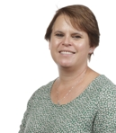
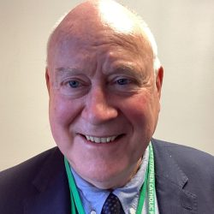
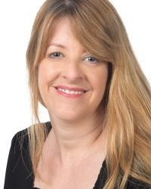
Our Senior Leadership Team
Mr P. Keane
Headteacher
Ms T. Hackett
Head of School
Mrs C. Smith
Assistant Headteacher & SENDCO
Mrs C. Smith
Assistant Headteacher
& SENDCO

Slide 6
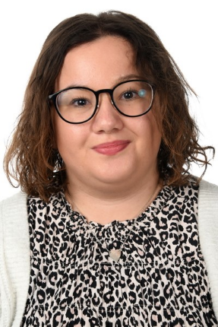
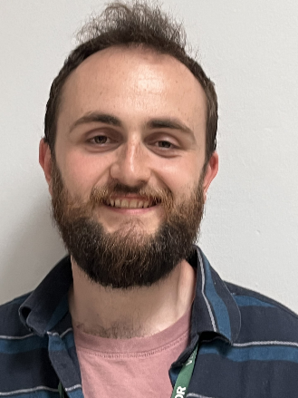
Year 4 Staff
Beech Class
Ms Mannering
Class teacher
Beech Class
Miss Sedgman
Hazel and Beech Classes
Mr McDonagh
Hazel Class
Mrs Shenton
Hazel Class
Mrs Jayamana

Slide 7
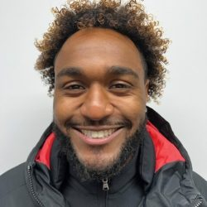
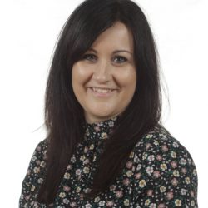
Other Staff Members
P.E, Music and French (Key Stage 2) will be covered by specialist teachers.
Mrs Tennant
Phase Leader
Lower Key Stage 2
Mr S. Wallace
P.E Specialist
Mrs Z. Flatt
Music Specialist
Mrs A. Harvey
French Specialist
Mrs C. Smith
Assistant Headteacher
& SENDCO

Slide 8
Drop Off and Pick Up
The doors open at 8.45am and close at 8.55am. There is a soft start to the day and when the children arrive they start their SODA (Start of Day Activity) before lessons begin. Children arriving after 8.55 will be marked late.
Please help your child settle by allowing them to come in to the classroom independently.
School finishes at 3.20pm.

Slide 9
Lunches
We encourage parents to discuss school lunches with their child and to book their lunch choices in advance using Arbor.
This ensures that parents help their child to choose a meal they know that they will like and also means a quicker start to the school day .
Red: Meat/Fish option
Green: Vegetarian option
Yellow: Roll or sandwich
Blue: Jacket Potato
Alternatively, your child can bring in their own packed lunch. No glass bottles, fizzy drinks or any food containing nuts are allowed.
Mrs C. Smith
Assistant Headteacher
& SENDCO

Slide 10
KS2 School Stationery
Children may bring one simple pencil case labelled with their name containing:
A pencil and sharpener; 2 spare pencils
A black handwriting pen (not black biro) and a purple pen
A rubber
Colouring pencils and felt tips
A glue stick
A ruler - 30cm
Please ask your child to tell you when they need replacements. Stationery can be provided in school if your child does not want to bring their own pencil case.
Notes:
Maria
Please ensure pencil cases are of a modest size and only contain school equipment.

Slide 11
Uniform
Please ensure all items of clothing are CLEARLY MARKED WITH YOUR CHILD’S NAME.
Black school shoes must be worn – no trainers.
Long hair must be tied up with simple black, green or red ties.
Jewellery – children may only wear simple stud earrings and a silent watch or Fitbit (no smartwatches allowed).
Appropriate outer wear must be provided as children play outside.
Red caps are required to be worn on sunny days and during trips.

Slide 12
PE Kit
Please ensure all items of clothing are CLEARLY MARKED WITH YOUR CHILD’S NAME.
Children need to have correct PE Kit in school for their PE days. Our PE days are Monday and Thursday. P.E kits to be brought in on Mondays and kept in school all week.
Plain white T shirt (with or without school logos but no other logos)
Red shorts
Plain trainers with non-marking soles
Optional for cold weather – Plain dark tracksuit bottoms and sweatshirt for outdoor use, i.e. black, navy, or green without logos
Red drawstring bag (clearly labelled)
No jewellery should be worn.

Slide 13
R.E.: Come and See
Autumn Term
Domestic Church - People
Baptism/Confirmation - Called
Other Faiths-Judaism – The Torah
Advent/Christmas: Gift
Spring Term
Local Church – Communion
Eucharist – Giving and Receiving
Lent/Easter – Self-discipline
Summer Term
Pentecost – New Life
Other Faiths- Hinduism – Sacred Writings
Reconciliation – Building Bridges
Universal Church – God’s People
Notes:
Lisa

Slide 14
Maths in Year 4
Place value, rounding numbers
Revision written addition & subtraction.
Multiplication & division – facts, formal written layout
Factor pairs, integer scaling & correspondence problems
Multiply & divide by 10/100
Measure – conversion of units
Discrete and continuous data, including scales.
Area & Perimeter
Properties of shape - angles, properties of triangles
Symmetry
Calculating with decimal numbers
Measure – money
Fractions – add & subtract, fractions of quantities & measures, equivalent fractions
Time – analogue & digital – 12 hour & 24 hour clocks
Statistics – interpret continuous & discrete data
Roman numerals to 100 and 0
Negative numbers
Geometry –Geometry – coordinates & translations.
Notes:
delete

Slide 15
Reading in Year 4
Reading frequently is important so please aim to read daily at home – reading books and other reading material from a variety of genres (e.g. non-fiction, magazines, newspapers, recipes, poetry.)
Develop Comprehension by questioning children (VIPERS – Vocabulary, Inference, Predict, Explain, Retrieval, Summarise)
Guided reading sessions in school to teach skills of reading.
Library books – please read and return for weekly library sessions
Notes:
delete

Slide 16
Spelling in Year 4
Weekly spelling patterns taught and homework given
Prefixes e.g. un-, in-, dis-
Suffixes e.g. -ure, -ful
Spelling and reading Year 3 and 4 words from memory.
Notes:
delete

Slide 17
Writing in Year 4
Children use black handwriting pens
Cursive (joined handwriting)
Writing for a range of purposes e.g. non-chronological reports, narrative, explanations, persuasion, biography, diary writing.
Reading widely will benefit children in their writing ability.
Notes:
delete

Slide 18
Science in Year 4
Living things and their habitats
States of Matter
Sound
Electricity
Animals including humans

Slide 19
Other curriculum topics in Year 4
History
Geography
Computing
Art and design
Design and Technology
PSHE
PE
Music
French

Slide 20
Home Learning
Daily reading
Times tables practise
Weekly Maths and Spellings
Termly Home Learning grid – 6 pieces including 2 RE Please remember to submit RE under the RE assignments and a separate piece of homework for each of the other assignments
Times Tables Rock Stars & Numbots.

Slide 21
How you can help at home
Reading and asking questions about it
Real life Maths, e.g. telling the time and cooking
Encourage children to complete homework and to present neatly
Having named equipment in school
Talking to your children about what they have been learning
Home liaison booklets if you need to send in a message.

Slide 22
Parent Helpers
The support of parents is of enormous benefit to the children and we warmly welcome it.
We already have a team of fantastic parent volunteers who read with children and help in the library every week. If you are interested in becoming a regular volunteer, please notify the office and further information will follow.
(Please note that in line with Hertfordshire County Council, all parents working in school will be asked to apply for police clearance.)
Notes:
Lisa

Slide 23
Any Questions?
If you have any further questions, please email the office:
admin@ssas.herts.sch.uk
We will try to get back to you as soon as possible.

Slide 24
Thank you for your support.
We hope that you found this information useful. We are very much looking forward to getting to know your families and children this year.

