Slide 1


St Alban & St Stephen
Catholic Primary School & Nursery
Welcome to Year 2
Learning and Growing with God by our Side
SEPTEMBER 2025

Slide 2
Our School Prayer
Dear God,
Bless all the children and staff in our school.
Bless all our loving parents, our school community and parishioners.
Let us follow the shining examples of St Alban and St Stephen.
Help us to be the best that we can be and guide us as we stay connected to you and Jesus in all that we do.
As a school, we are learning and growing with God by our side.
Amen.

Slide 3

Our Mission Statement

Slide 4



Slide 5
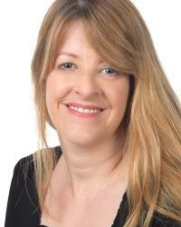
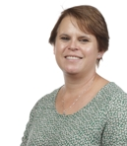
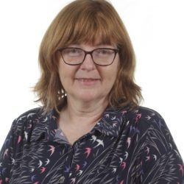
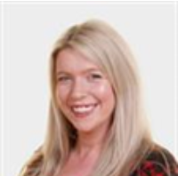
Our Senior Leadership Team
Mrs S Lavelle-Murphy Executive Headteacher
Ms T. Hackett
Head of School
Mrs C. Smith
Senior Assistant Headteacher & SENDCO
Mrs J. Bates Assistant Headteacher

Slide 6
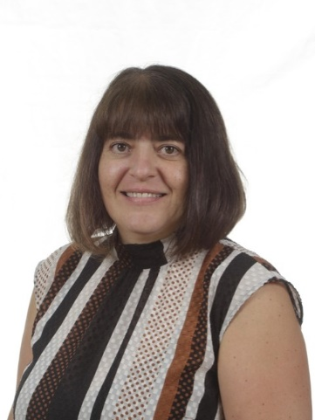
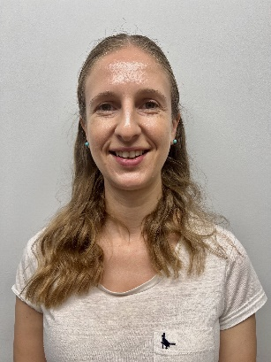
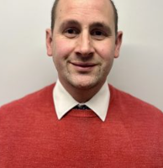
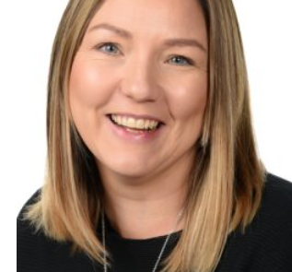
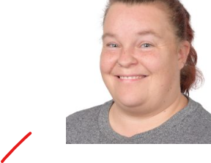
Year 2 Staff
Mrs Rose
Cherry Class Teacher/
KS1 Phase Lead
Mr Carr Cherry Class Teacher/Phase Lead
Mrs Pham
Willow Class Teacher
Mrs Realmuto
Willow Class
Teaching Assistant
Ms N Kendell
Cherry Class
Teaching Assistant
Ms Ruff
Willow Class
Teaching Assistant
Mrs C. Smith
Assistant Headteacher
& SENDCO

Slide 7
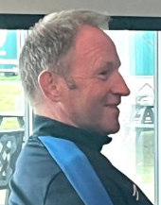
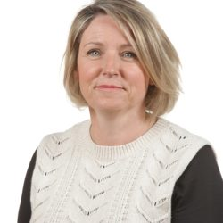
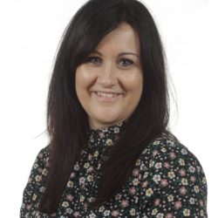
Other Staff Members
P.E and Music and will be covered by specialist teachers.
Mr D Byrne
P.E Specialist
Mrs Rees
Pastoral Mentor
Mrs Z Flatt
Music Specialist
Mrs C. Smith
Assistant Headteacher
& SENDCO

Slide 8
Drop Off and Pick Up
The doors open at 8.45am and close at 8.55am. There is a soft start to the day and when the children arrive, they start their SODA (Start of Day Activity) before lessons begin. Children arriving after 8.55 will be marked late.
Please help your child settle by allowing them to come into the classroom independently.
School finishes at 3.05 (Reception) 3.15 (KS1) 3.20(KS2)
Other adults who regularly pick up your child should be added to Arbor. For one-off occasions, please inform the teacher or email into the office with the adult’s name, their role, and whether your child is expecting to be picked up by this person or not. Children in Nursery to Year 4 can only be picked up by an older sibling who is aged 14+ (Year 10+)- you must inform the Office of this in writing or by email.

Slide 9
Uniform
Please ensure all items of clothing are
CLEARLY MARKED WITH YOUR CHILD’S NAME.
Black school shoes must be worn – no trainers.
Long hair must be tied up with simple black, green or red hair ties.
Jewellery – children may only wear simple stud earrings and a silent watch or Fitbit (no smartwatches allowed). No necklaces, bracelets, charity bands etc are allowed.
A warm, waterproof coat must be provided as children play outside.
Red caps must be worn on sunny days and during trips.
Summer uniform can be worn for the first Autumn half term.

Slide 10
KS1 PE Kit
Please ensure all items of clothing are
clearly marked with your child’s name.
Children need to have correct PE Kit in school for their PE days. Our PE days are Tuesday and Thursday. Children to come in their PE kits both days.
Plain white T shirt (with or without school logos but no other logos)
Plain dark tracksuit bottoms
Red school zip up hoodie
Plain trainers with non-marking soles
No jewellery should be worn.

Slide 11

R.E.
Notes:
Lisa

Slide 12
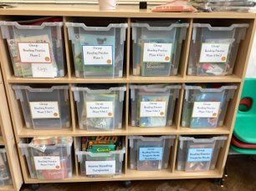
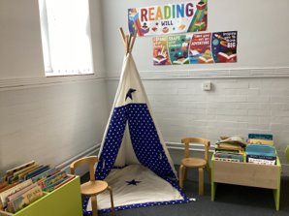
Reading in Year 2
Our school uses a phonics scheme called Little Wandle.
Our reading scheme books are closely matched to your child's phonics ability. The reading book that each child brings home should be read with 95% accuracy which is why it is very important that the book matches their phonics ability.
After Phase 5 Set 5, children will move onto coloured.
Please make sure that books are brought into school every day..
Children will start to bring home two books: one is a home reading book and one is a reading practice book.
The new reading practise book will be given out each Thursday.
Children will have the opportunity to visit our school library once every 2 weeks.
The children will also be visiting the library once a week to choose a book to bring home and share with family members.
Notes:
delete

Slide 13

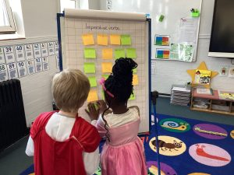

Writing in Year 2
In year 2, children should learn a range of English language and literature skills, such as reading common exception words, recognising suffixes, spelling homophones and writing simple narrative stories. The main areas that are addressed in the year 2 English classroom include:
Transcription (Handwriting)
Writing Composition
Grammar, Spelling, Punctuation and Vocabulary
The stimulus for writing comes from our whole class texts;
Paddington Bear and
Katie in London by James Mayhew
Notes:
delete

Slide 14
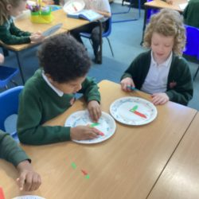
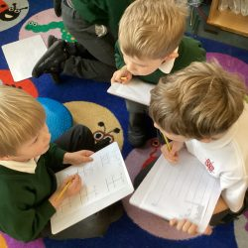
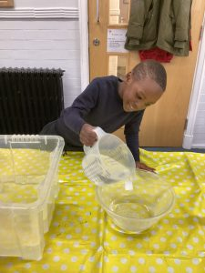
Maths in Year 2
Daily Maths lesson/Maths fluency 3 x a week
In Year 2, we cover:
  Place Value (up to 100)
  Addition and subtraction facts (up to 20)
  Multiplication and Division (including the 2, 3 and 5 times tables)
  Properties of shape – common 2D and 3D shapes
  Simple Fractions
  Measurement – Length and Height
  Position and Direction
  Time – up to quarter to and quarter past
  Money
  Problem Solving basics (both number problems and word problems)
  We aim to develop a strong visual awareness of number and so use a lot of practical equipment in the classroom such as a ten-frame until children can subitise these numbers fluently.
Notes:
delete

Slide 15
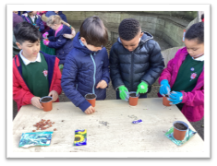
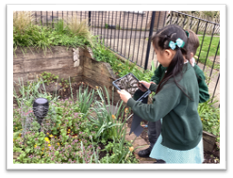
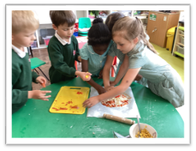
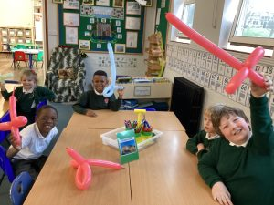
Science in Year 2
Healthy Me | Material Monster | Squash, Bend, Twist and Stretch | Our Local environment Livings things, habitats and food chains | Young Gardeners Plants | Little MasterChef

Slide 16
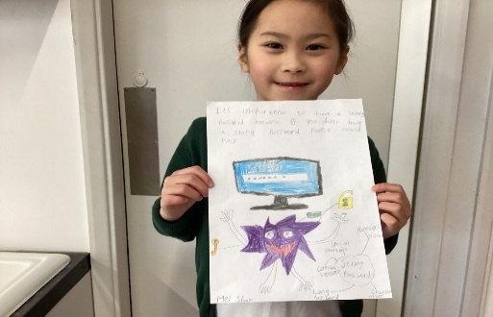
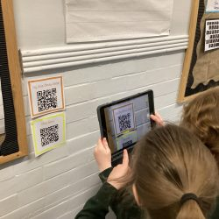
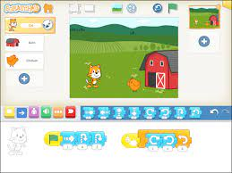
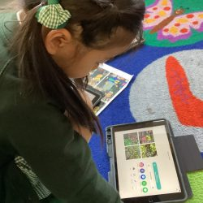
Computing in Year 2
Computing systems and networks 1: What is a computer? Exploring what a computer is by identifying how inputs and outputs work and how computers are used in the wider world to design their own computerised invention. E Safety | Programming 1: Algorithms and Debugging - Developing an understanding of; what algorithms are, how to program them and how they can be developed to be more efficient, introduction of loops. | Computing systems and networks 2: Word Processing – Developing touch typing skills, learning keyboard shortcuts and simple editing tools. E Safety | Programming 2: Scratch Junior – Exploring what ‘blocks’ do’ by carrying out an informative cycle of predict > test > review. Programming a familiar story and make a musical instrument. | Creating Media: Stop Motion - Learning how to create simple animations from storyboarding creative ideas. E Safety | Data Handling: International Space Station Learning how data is collected, used and displayed and the scientific learning of the conditions needed for plants and humans, to survive.

Slide 17
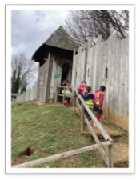
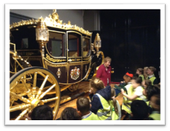
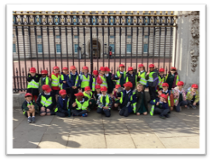
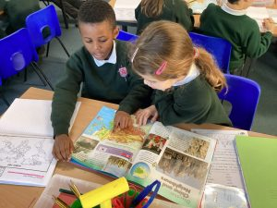
History and Geography in Year 2
London today Big Question: Why is London an important city? | London in the past: The Great Fire and Gunpowder Plot Big Question: Why and how do we remember these events? | The World and Me: Asia (Hong Kong) Big Question: How is Hong Kong different to the place that I live? | Castles Big Question: Why don’t people live in castles anymore? | Oceans Big Question: Why do we need to protect our oceans? | Local history of our school: The Orchid King of St Albans Big question: What happened here in the past and how do we know?

Slide 18
Assessment in Year 2
There will not be any formal SATs assessments in Year 2.
Instead, we will conduct informal assessments to inform any
areas for further teaching.

Slide 19
Home Learning
Maths homework in Year 2 is sometimes set on ‘My Maths’, sometimes TT Rockstars and sometimes on paper. It goes out on a Wednesday and is due in on Monday.
Times tables will be available and the children can achieve rewards for the amount they practice.
Additional maths will be available on Numbots. This will be monitored for participation.
Spellings will be given out on a Wednesday for a ‘check’ on Mondays.
All children should read for 10 minutes a day. Please record this in their Reading Journals.
The children are also given a grid of topic-based activities for home learning at the start of the term. We ask that they complete at least 3 pieces across the whole term. (This system is currently under review. Pending parental feedback this is subject to change later in the Autumn term)
We will send out reminders of logins.

Slide 20
How you can help at home
Ensuring your child maintains a high level of attendance and is punctual
Maths games - (dice games, card games, online e.g. Topmarks)
Practise Times Table Rockstars / Numbots.
Play My Maths games
Practise times tables and mental maths regularly
Cooking and baking
Telling the time
Problem solving at the shops
Reading

Slide 21
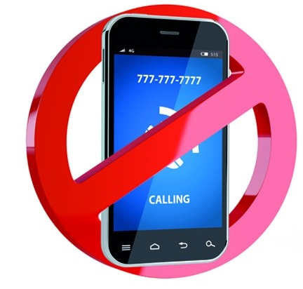
Smartphone-Free School
A significant number of St Albans primary schools have agreed to support the ‘Smartphone-Free Childhood initiative. https://smartphonefreechildhood.co.uk/ https://delaysmartphones.org.uk/
By “smartphones”, we refer to phones that are able to access the internet, as opposed to old-fashioned mobile phones that can only text and make phone calls.
After consulting with staff, parents and governors, we have agreed that at SAS primary-aged pupils should not have smartphones.
Primary-aged pupils should not be on any age-inappropriate social media including WhatsApp, Snapchat, Instagram or TikTok (all have a 13+ age-restriction).

Slide 22
What does this mean for you?
From September 2025, no SAS child will be able to bring a smartphone to school when they walk to and from school. From September 2024, only our current Year 6 pupils who walk to and from school by themselves have been allowed to bring smartphones (as this was already allowed for them last year).
Year 5 and 6 children who walk to and from school by themselves can, if parents wish, bring a tracker or an old-fashioned phone which does not connect to the internet eg a Nokia.
All phones must be handed into the class teacher at the start of the day and will be returned at the end of the day.
We ask parents not to buy their child a smartphone while in primary school. We ask that parents do not allow their child to access age-inappropriate social media and join WhatsApp groups.
Parents on school grounds are not allowed to use mobile phones unless outside the school gates. This is a safeguarding issue. It also sends a message to our children that they are more important than our phones and sets a positive example.

Slide 23

Parent Helpers (and other adults)
The support of parents is of enormous benefit to the children, and we warmly welcome it.
We can now invite parent volunteers back to help in school. If you are interested in becoming a volunteer, please notify the office and further information will follow.
(Please note that in line with Hertfordshire County Council, all parents working in school will be asked to apply for police clearance.)
Notes:
Lisa

Slide 24

PTA
Parent Teacher Association
SSAS's PTA organize events to raise money for our school.
During the last academic year the PTA raised over £28,000! Money raised by the PTA helped to fund new phonics reading books for EYFS/KS1, an environmental tutor, anti-bullying workshops, a swimming coach and much more.
But.. we need you!
Please join us for the PTA's AGM is on the 17th October 7pm.
Email: ssaspta@gmail.com
Or drop us a note into the school office.
Notes:
Lisa

Slide 25
DATES FOR YOUR DIARY

Slide 26
Any Questions?
If you have any further questions after the welcome meeting, please email the office:
admin@ssas.herts.sch.uk
We will try to get back to you as soon as possible.

Slide 27

Thank you for your support.
We hope that you found this information useful. We are very much looking forward to getting to know your families and children this year.

