Slide 1

St Alban & St Stephen
Catholic Primary School & Nursery
Welcome to Year 4
Learning and Growing with God by our Side
SEPTEMBER 2025

Slide 2
Our School Prayer
Dear God,
Bless all the children and staff in our school.
Bless all our loving parents, our school community and parishioners.
Let us follow the shining examples of St Alban and St Stephen.
Help us to be the best that we can be and guide us as we stay connected to you and Jesus in all that we do.
As a school, we are learning and growing with God by our side.
Amen.

Slide 3

Our Mission Statement

Slide 4



Slide 5
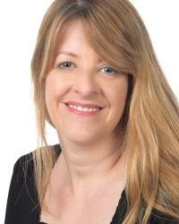

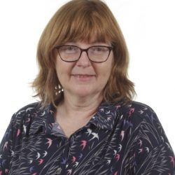

Our Senior Leadership Team
Mrs S. Lavelle Murphy Executive Headteacher
Ms T. Hackett
Head of School
Mrs C. Smith
Senior Assistant Headteacher & SENDCO
Mrs J. Bates Assistant Headteacher
Mrs C. Smith
Assistant Headteacher
& SENDCO

Slide 6
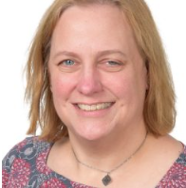
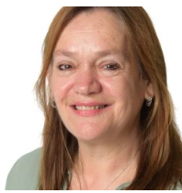
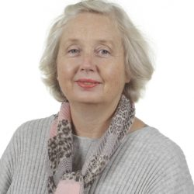
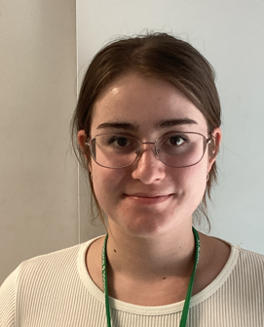
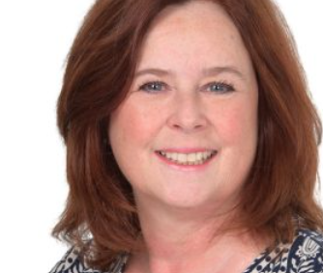
Year 4 Staff
Mrs Tennant
Hazel Class teacher & Phase lead
Mrs Rindfleisch
Beech Class Teacher
Mrs Moss
Teaching Assistant
Miss Cole
Ms Mannering Cover & Maths Support
Mrs C. Smith
Assistant Headteacher
& SENDCO

Slide 7
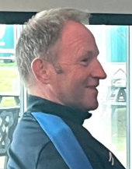
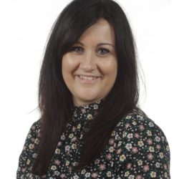
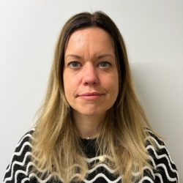
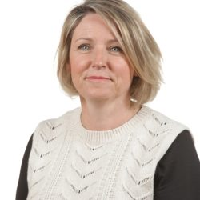
Other Staff Members
P.E (KS1 and 2), Music (KS1 and 2) and French (Key Stage 2 only) will be covered by specialist teachers.
Mr D. Byrne
Sports Coach
Mrs Z. Flatt
Music Specialist
Mrs A. Harvey
French Specialist
Mrs Rees
Pastoral Mentor
Mrs C. Smith
Assistant Headteacher
& SENDCO

Slide 8
Drop Off and Pick Up
The doors open at 8.45am and close at 8.55am. There is a soft start to the day and when the children arrive, they start their SODA (Start of Day Activity) before lessons begin. Children arriving after 8.55 will be marked late.
Please help your child settle by allowing them to come into the classroom independently.
School finishes at 3.05 (Reception) 3.15 (KS1) 3.20(KS2)
Other adults who regularly pick up your child should be added to Arbor. For one-off occasions, please inform the teacher or email into the office with the adult’s name, their role, and whether your child is expecting to be picked up by this person or not. Children in Nursery to Year 4 can only be picked up by an older sibling who is aged 14+ (Year 10+)- you must inform the Office of this in writing or by email.

Slide 9
Lunches
We encourage parents to discuss school lunches with their child and to book their lunch choices in advance using Arbor.
This ensures that parents help their child to choose a meal they know that they will like and also means a quicker start to the school day .
Red: Meat/Fish option
Green: Vegetarian option
Yellow: Roll or sandwich
Blue: Jacket Potato
Alternatively, your child can bring in their own packed lunch. No glass bottles, fizzy drinks or any food containing nuts are allowed.
Mrs C. Smith
Assistant Headteacher
& SENDCO

Slide 10
KS2 School Stationery
Children may bring one simple pencil case labelled with their name containing:
A pencil and sharpener; 2 spare pencils
A black handwriting pen (not black biro) and a purple pen
A rubber
Colouring pencils and felt tips
A glue stick
A ruler - 30cm
Please ask your child to tell you when they need replacements. Stationery can be provided in school if your child does not want to bring their own pencil case.
Notes:
Maria
Please ensure pencil cases are of a modest size and only contain school equipment.

Slide 11
Uniform
Please ensure all items of clothing are
CLEARLY MARKED WITH YOUR CHILD’S NAME.
Black school shoes must be worn – no trainers.
Long hair must be tied up with simple black, green or red hair ties.
Jewellery – children may only wear simple stud earrings and a silent watch or Fitbit (no smartwatches allowed). No necklaces, bracelets, charity bands etc are allowed.
A warm, waterproof coat must be provided as children play outside.
Red caps must be worn on sunny days and during trips.
Summer uniform can be worn for the first Autumn half term.

Slide 12
PE Kit
Please ensure all items of clothing are CLEARLY MARKED WITH YOUR CHILD’S NAME.
Our PE days are Wednesday and Thursday. Children should wear their P.E. kit to school on P.E. days.
Plain white T shirt (with or without school logos but no other logos)
Red shorts/ black leggings or tracksuit bottoms
Red hoodie with NO DRAWSTRING (plain red or with school logo but no other logos) or school jumper/ cardigan
Plain trainers with non-marking soles
No jewellery should be worn.

Slide 13

R.E.
Autumn Term
Creation and Covenant - Abraham
Prophecy and Promise - Advent
Spring Term
Galilee to Jerusalem - Teachings of Jesus
Desert to Garden - Lent and Easter
Summer Term
To the ends of the Earth - St Paul
Dialogue and encounter - Other Faiths
Notes:
Lisa

Slide 14
Reading in Year 4
Reading frequently is important so please aim to read daily at home – reading books and other reading material from a variety of genres (e.g. non-fiction, magazines, newspapers, recipes, poetry.)
Develop Comprehension by questioning children (VIPERS – Vocabulary, Inference, Predict, Explain, Retrieval, Summarise)
Guided reading sessions in school to teach skills of reading.
Library books – please read and return for weekly library sessions
Notes:
delete

Slide 15
Spelling in Year 4
Weekly spelling patterns taught and homework given
Prefixes e.g. un-, in-, dis-
Suffixes e.g. -ure, -ful
Spelling and reading Year 3 and 4 words from memory.
Notes:
delete

Slide 16
Writing in Year 4
Children use black handwriting pens
Cursive (joined handwriting)
Writing for a range of purposes e.g. non-chronological reports, narrative, explanations, persuasion, biography, diary writing.
Reading widely will benefit children in their writing ability.
Notes:
delete

Slide 17
Maths in Year 4
Place value, rounding numbers
Revision written addition & subtraction.
Multiplication & division – facts, formal written layout
Factor pairs, integer scaling & correspondence problems
Multiply & divide by 10/100
Measure – conversion of units
Discrete and continuous data, including scales.
Area & Perimeter
Properties of shape - angles, properties of triangles
Symmetry
Calculating with decimal numbers
Measure – money
Fractions – add & subtract, fractions of quantities & measures, equivalent fractions
Time – analogue & digital – 12 hour & 24 hour clocks
Statistics – interpret continuous & discrete data
Roman numerals to 100 and 0
Negative numbers
Geometry –Geometry – coordinates & translations.
Notes:
delete

Slide 18
Science in Year 4
States of Matter
Sound
Electricity
Animals including humans
Living Things and their habitats.

Slide 19
Other curriculum topics in Year 4
History
Geography
Computing
Art and design
Design and Technology
PSHE
PE
Music
French

Slide 20
Year 4 MTC (Multiplication Tables
Check).
In June all Year 4 pupils will complete a National Times tables check.
6 seconds per question
All tables up to 12 times table.
Please practise at home as much as possible – this will really help the children.
TTRS (Times tables Rockstars) will produce heat map to show accuracy and speed of recall.

Slide 21
Home Learning
Daily reading
Times tables practice
Weekly Maths and Spellings
Termly Home Learning grid – 6 pieces including 2 RE Please remember to submit RE under the RE assignments and a separate piece of homework for each of the other assignments
Times Tables Rock Stars & Numbots.

Slide 22
How you can help at home
Reading and asking questions about books.
Real life Maths, e.g. telling the time and cooking.
Encourage children to complete homework and to present neatly.
Having named equipment in school.
Talking to your children about what they have been learning.

Slide 23
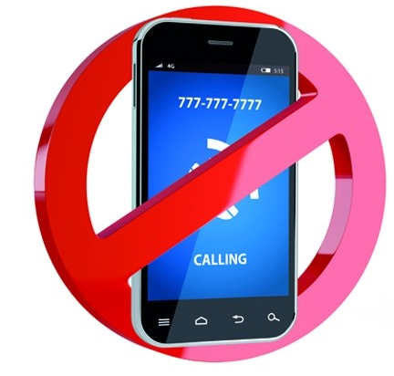
Smartphone-Free School
A significant number of St Albans primary schools have agreed to support the ‘Smartphone-Free Childhood initiative. https://smartphonefreechildhood.co.uk/ https://delaysmartphones.org.uk/
By “smartphones”, we refer to phones that are able to access the internet, as opposed to old-fashioned mobile phones that can only text and make phone calls.
After consulting with staff, parents and governors, we have agreed that at SAS primary-aged pupils should not have smartphones.
Primary-aged pupils should not be on any asocial media including WhatsApp, Snapchat, Instagram or TikTok (all have a 13+ age-restriction).

Slide 24
What does this mean for you?
From September 2025, no SAS child will be able to bring a smartphone to school when they walk to and from school. Year 5 and 6 children who walk to and from school by themselves can, if parents wish, bring a tracker or an old-fashioned phone which does not connect to the internet eg a Nokia.
All phones must be handed into the class teacher at the start of the day and will be returned at the end of the day.
We ask parents not to buy their child a smartphone while in primary school. We ask that parents do not allow their child to access age-inappropriate social media and join WhatsApp groups.
Parents on school grounds are not allowed to use mobile phones unless outside the school gates. This is a safeguarding issue. It also sends a message to our children that they are more important than our phones and sets a positive example.
Year 5 and 6 parents will need to complete the walk home from school form which was sent to you.

Slide 25

Parent Helpers
The support of parents is of enormous benefit to the children and we warmly welcome it.
We already have a team of fantastic parent volunteers who read with children and help in the library every week. If you are interested in becoming a regular volunteer, please notify the office and further information will follow.
(Please note that in line with Hertfordshire County Council, all parents working in school will be asked to apply for police clearance.)
Notes:
Lisa

Slide 26
Any Questions?
If you have any further questions, please email the office:
admin@ssas.herts.sch.uk
We will try to get back to you as soon as possible.
Lots of information can be found in the new parent and pupil handbook which was sent out to all parents before term started.

Slide 27

Thank you for your support.
We hope that you found this information useful. We are very much looking forward to getting to know your families and children this year.

